Slide 1
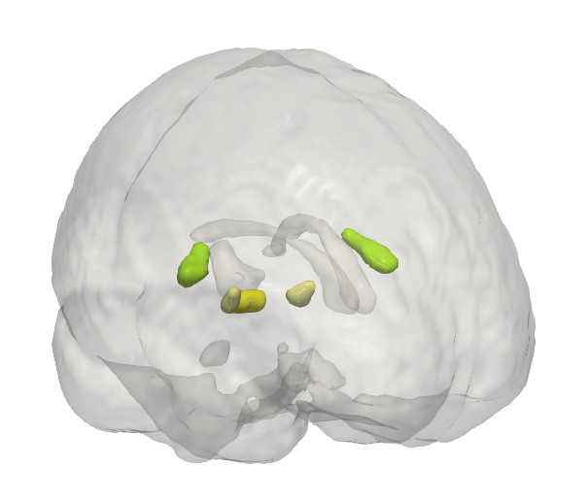
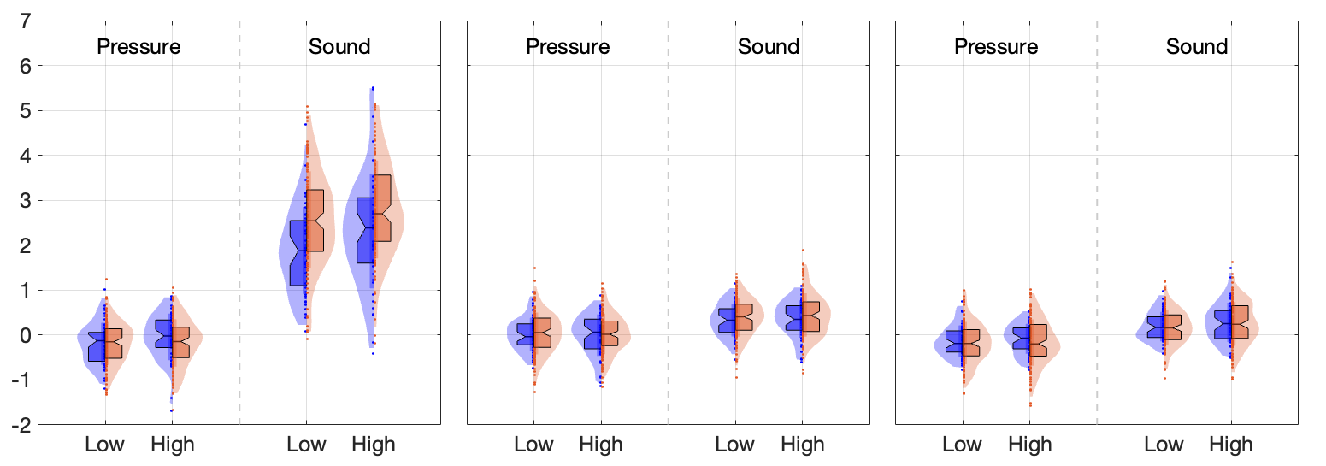
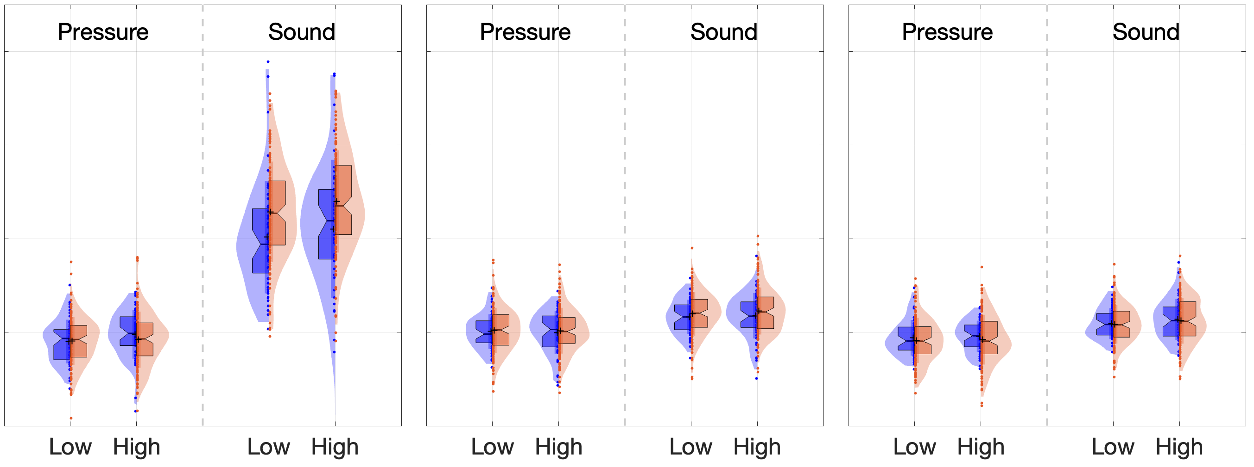

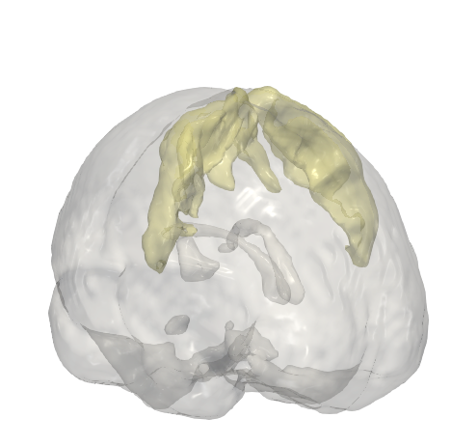
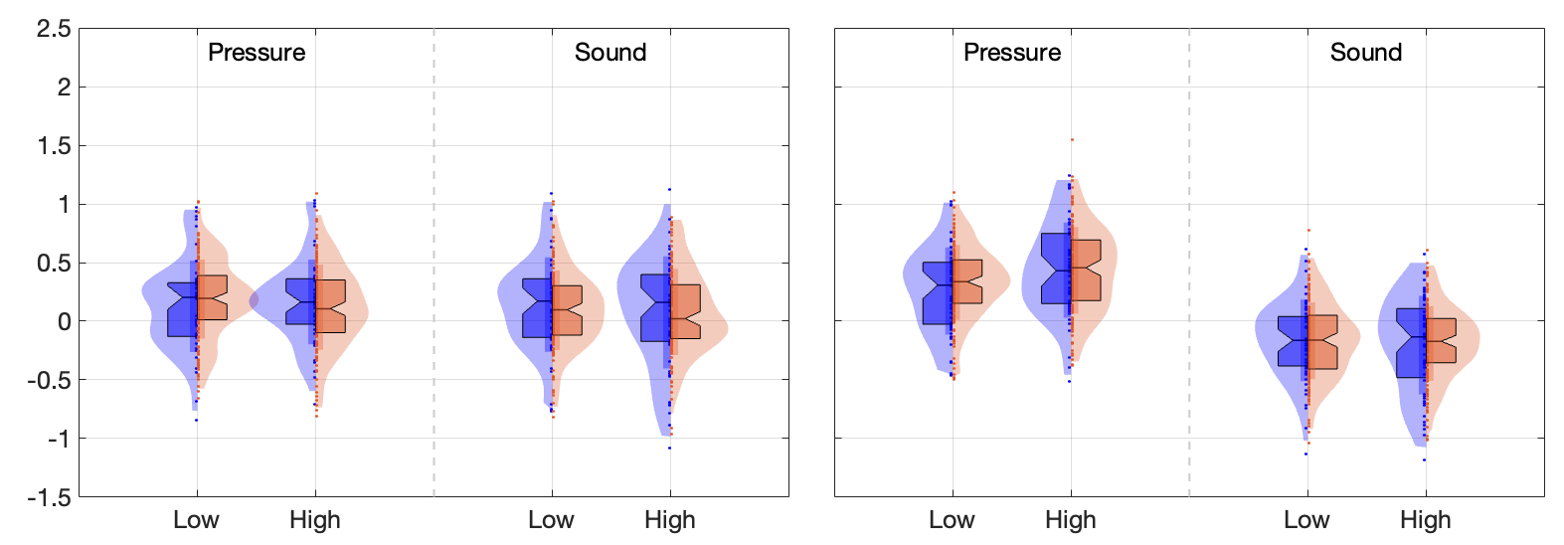
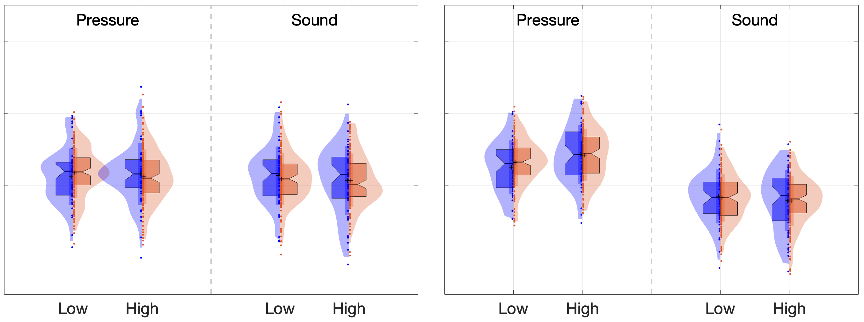
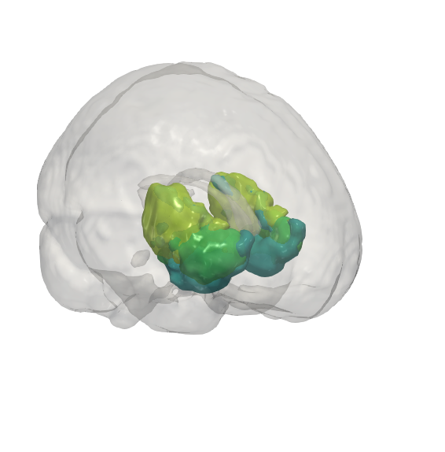
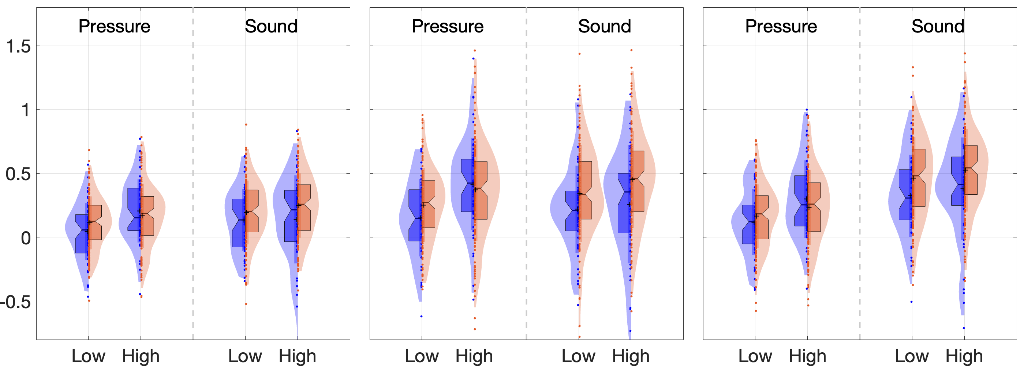
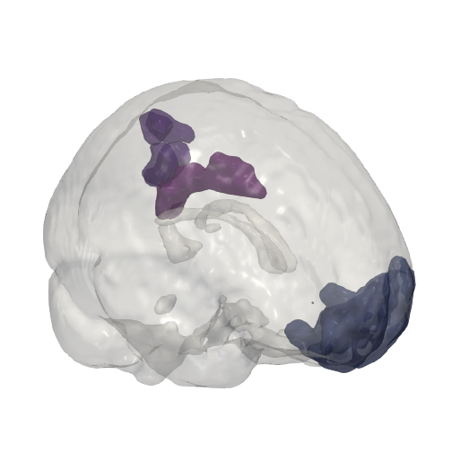
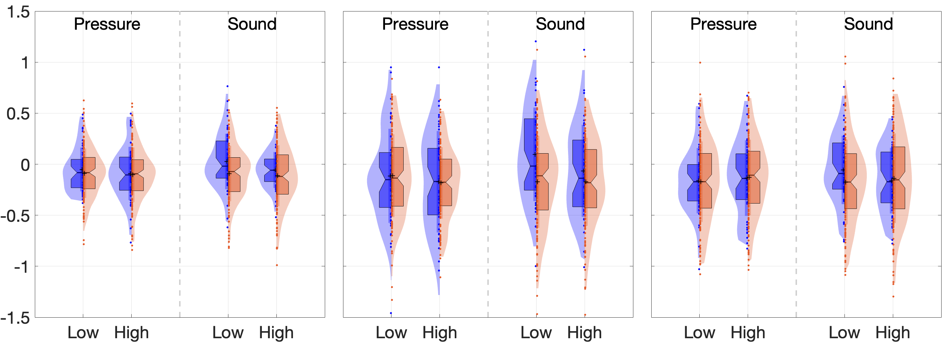
ANNALS OF NEUROLOGY
A
Uni-sensory: Auditory
☐
☐
☐
A1
MGN
IC
**
**
***
A1
MGN
IC
***
Modality specific
Intensity encoding
Group differences
B
Uni-sensory: Mechanical
S1 Left
S1 Right
Modality specific
S1 (L)
S1 (R)
Intensity encoding
**
Group differences
C
Sensory-integrative
vIns
dIns
pIns
**
**
**
**
**
vIns
dIns
pIns
*
*
Modality specific
Intensity encoding
Group differences
D
Midline Default-Mode Network Areas
mPFC
precuneus
PCC
*
**
Questions:
• checkbox?
**
***
Modality specific
mPFC
prec
PCC
Intensity encoding
Group differences
Controls
Chronic Back Pain

Slide 2
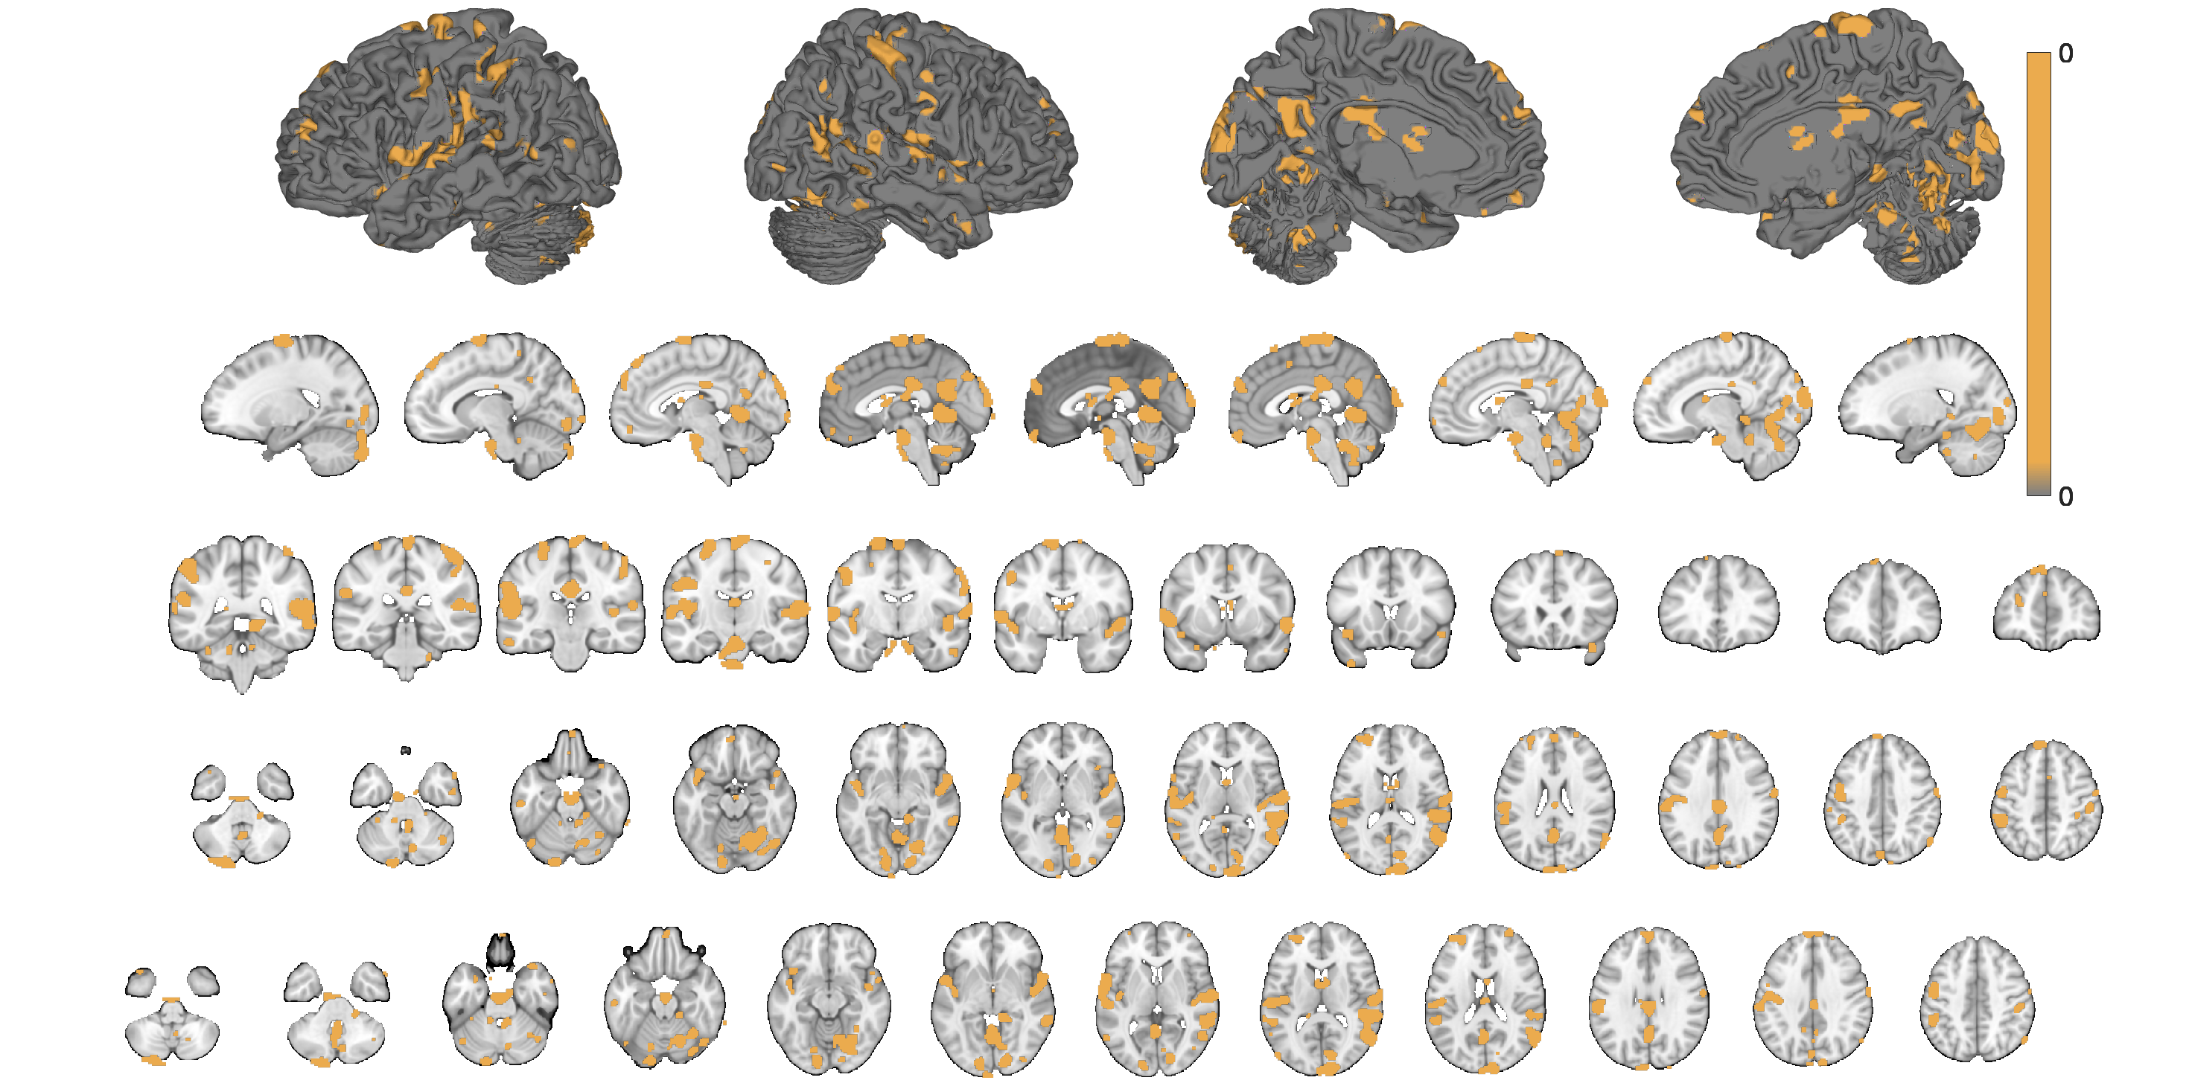
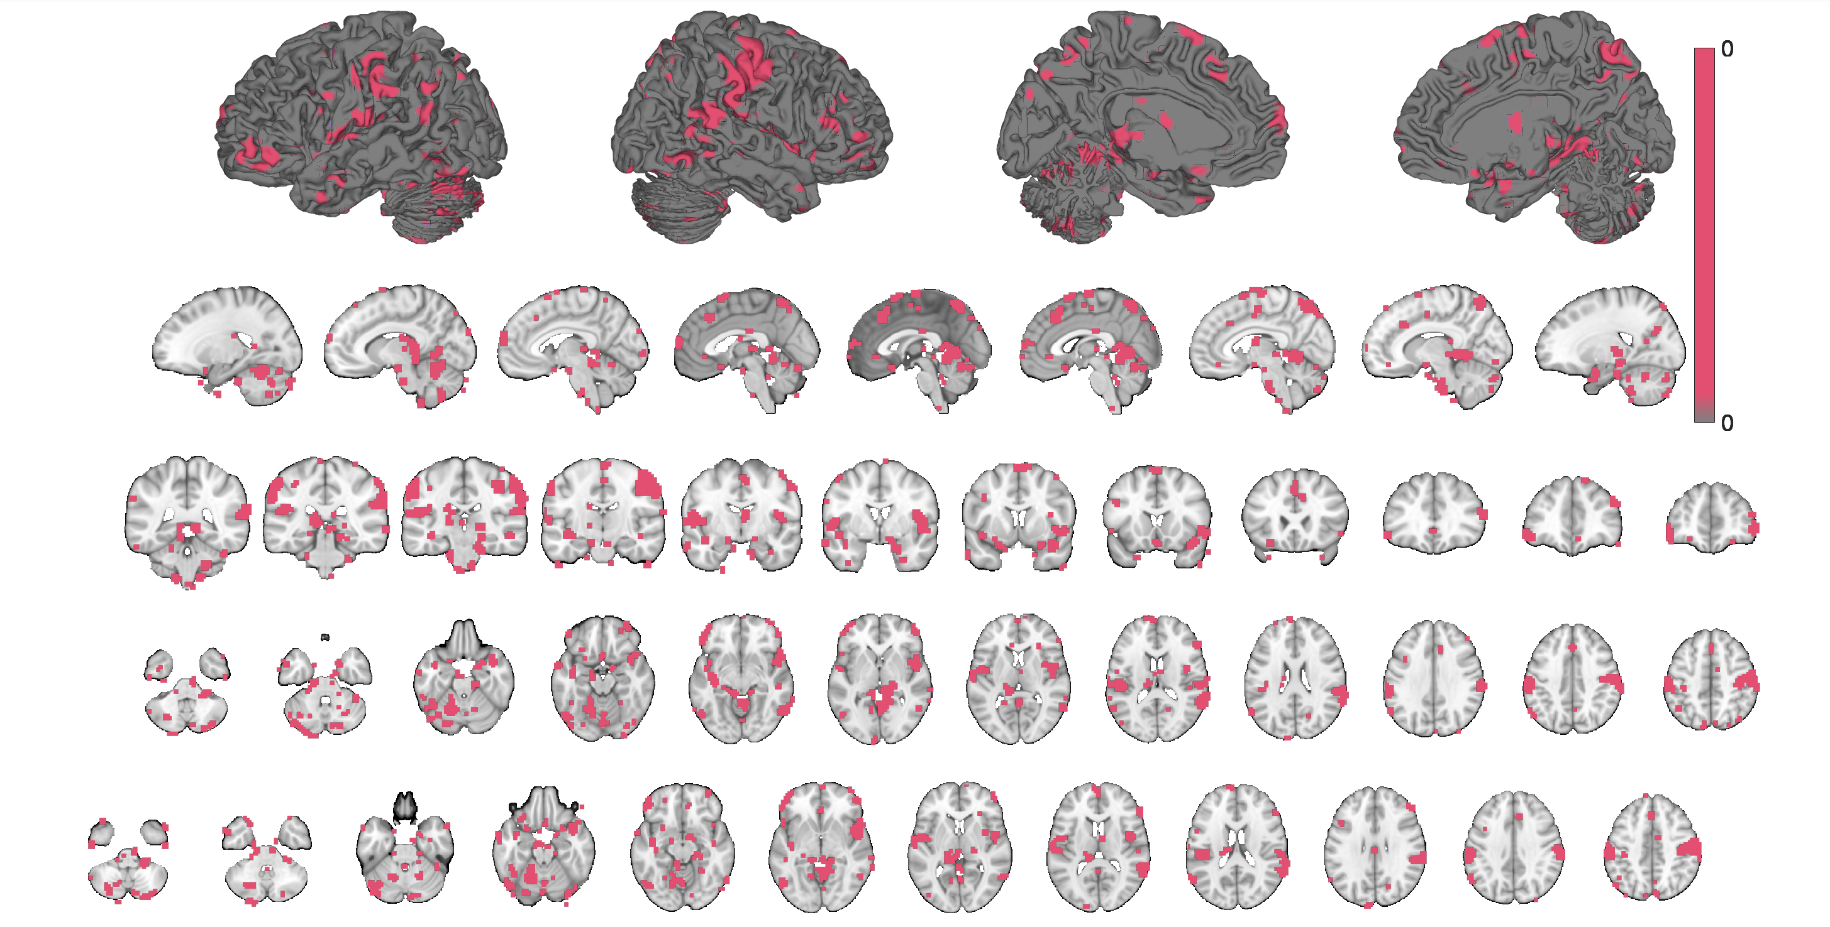
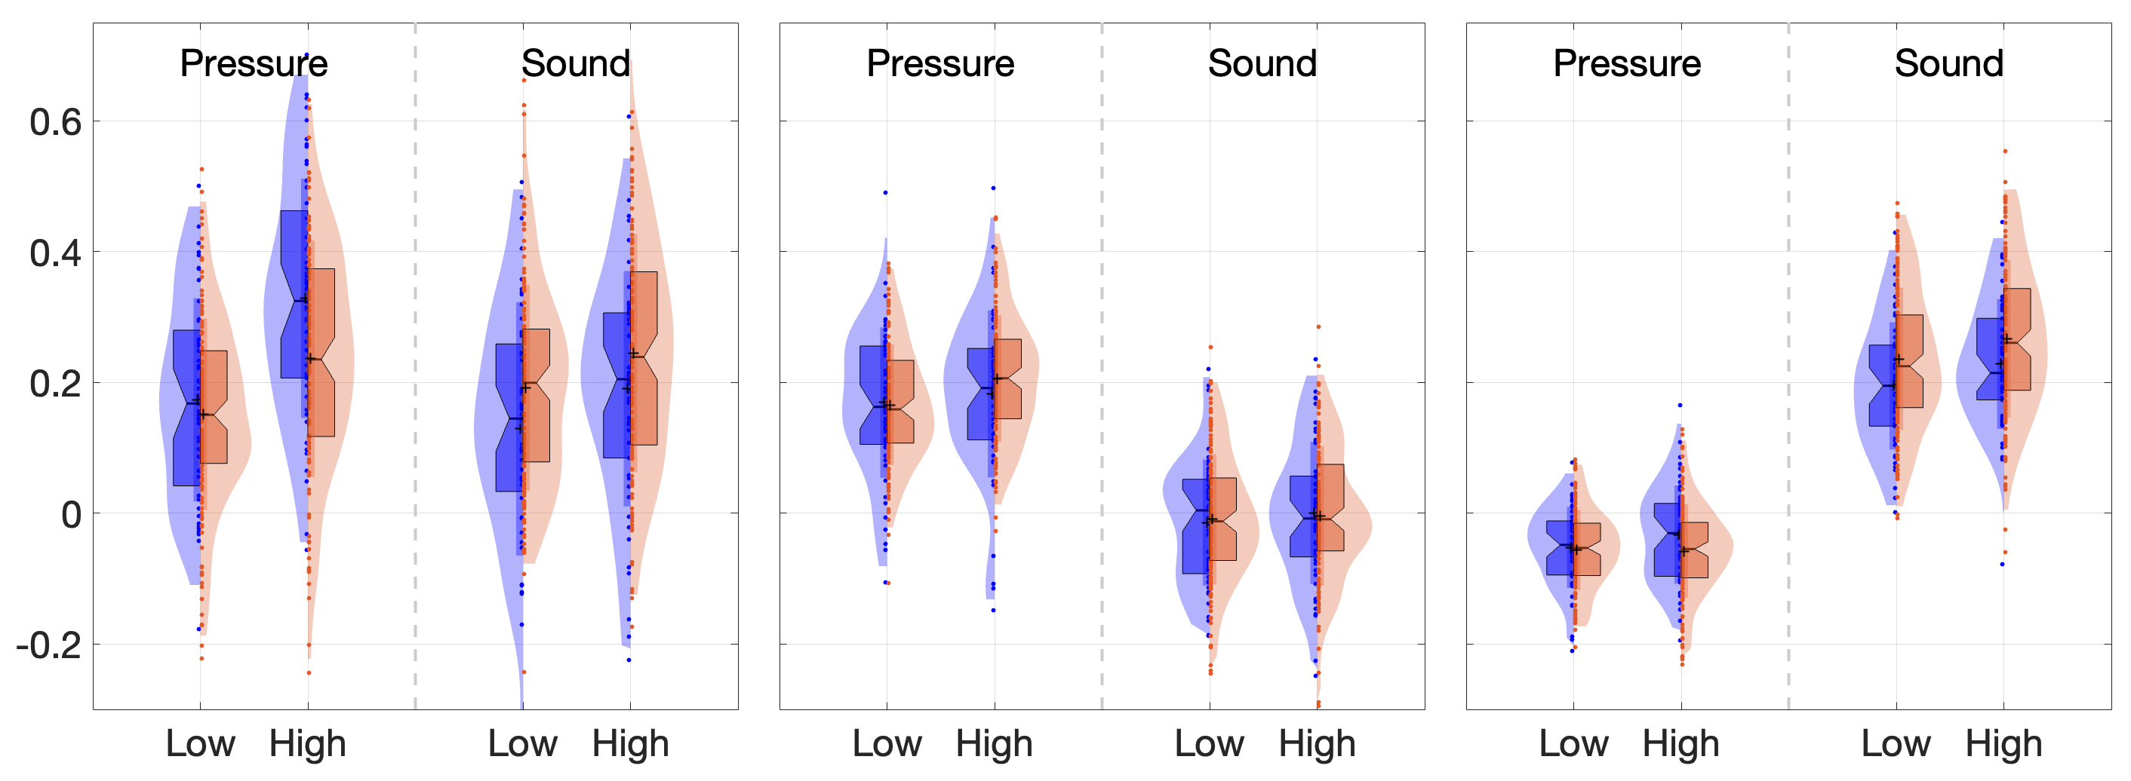
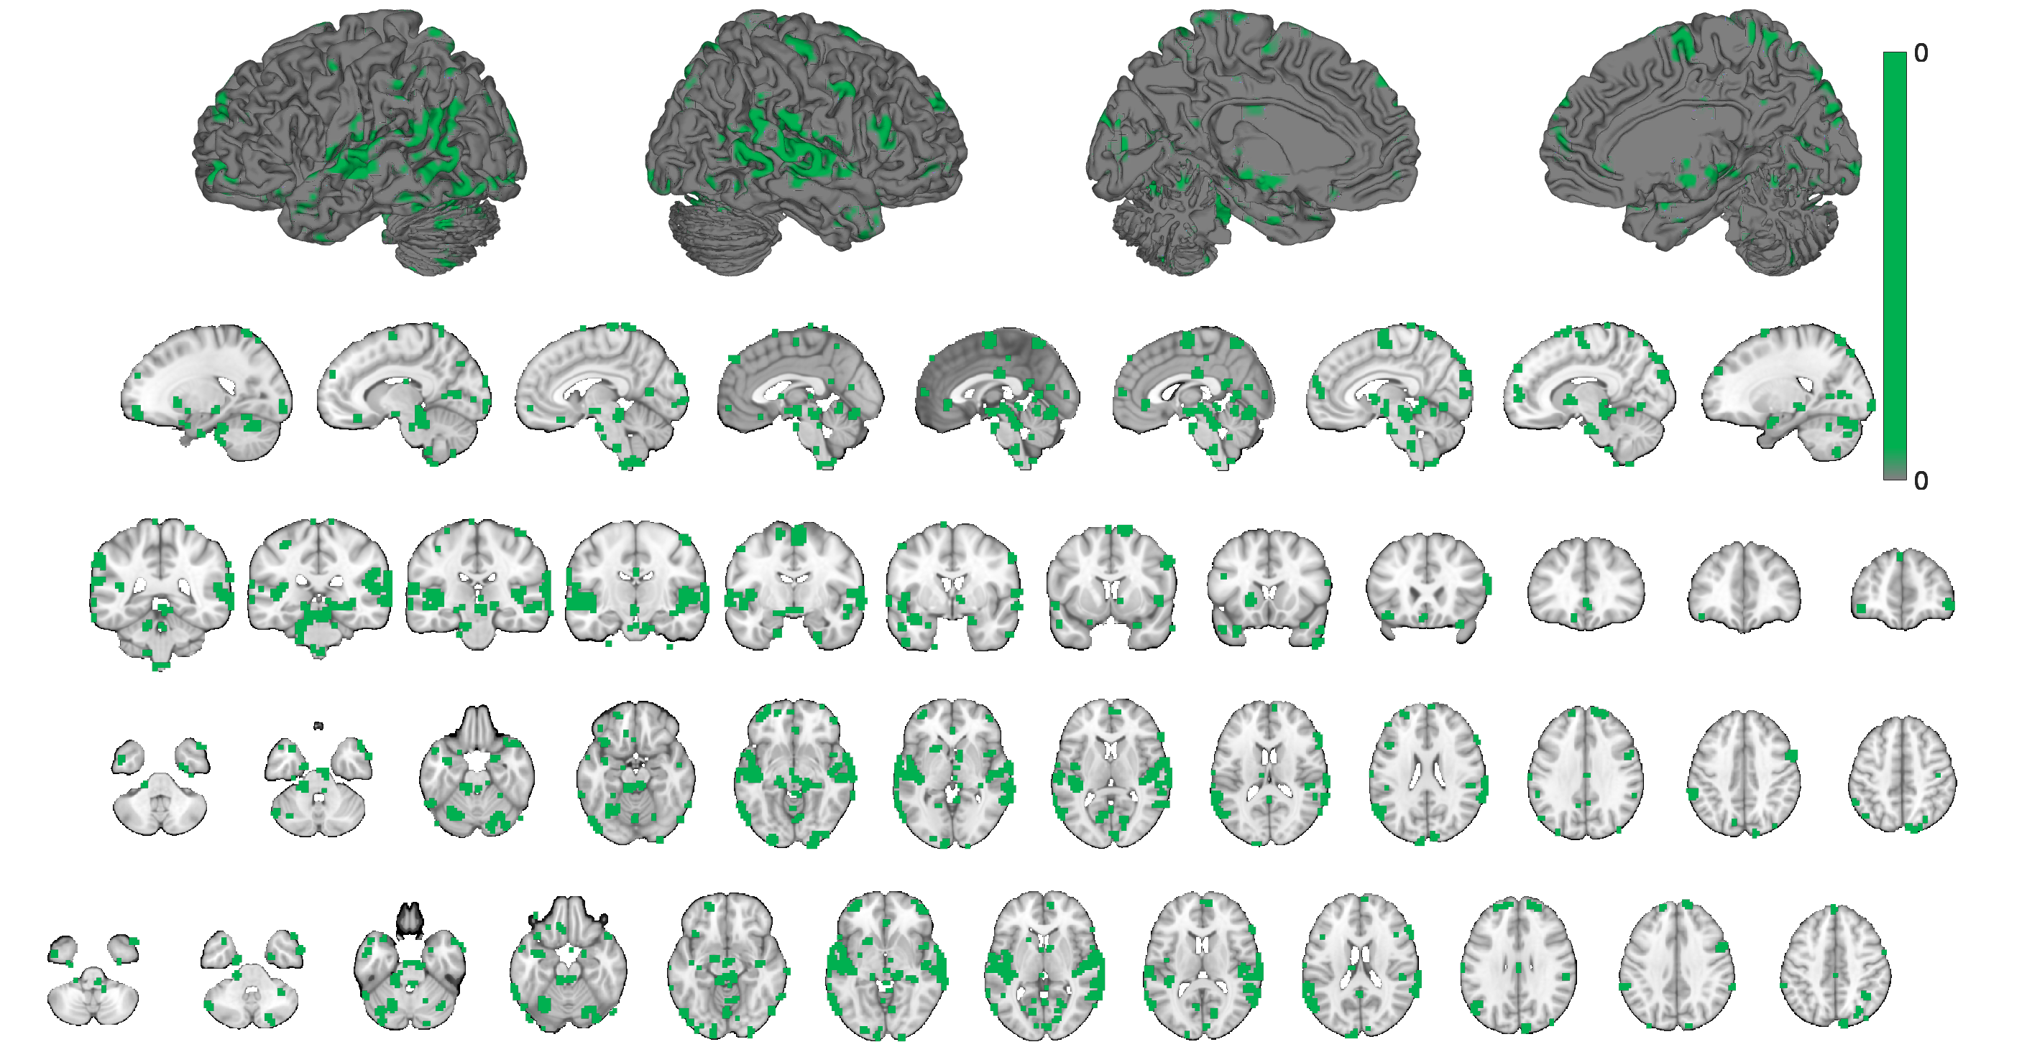
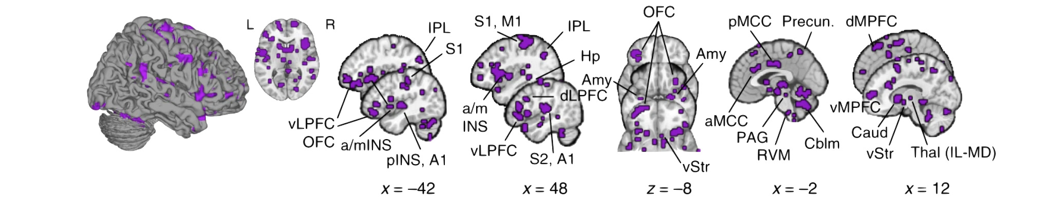
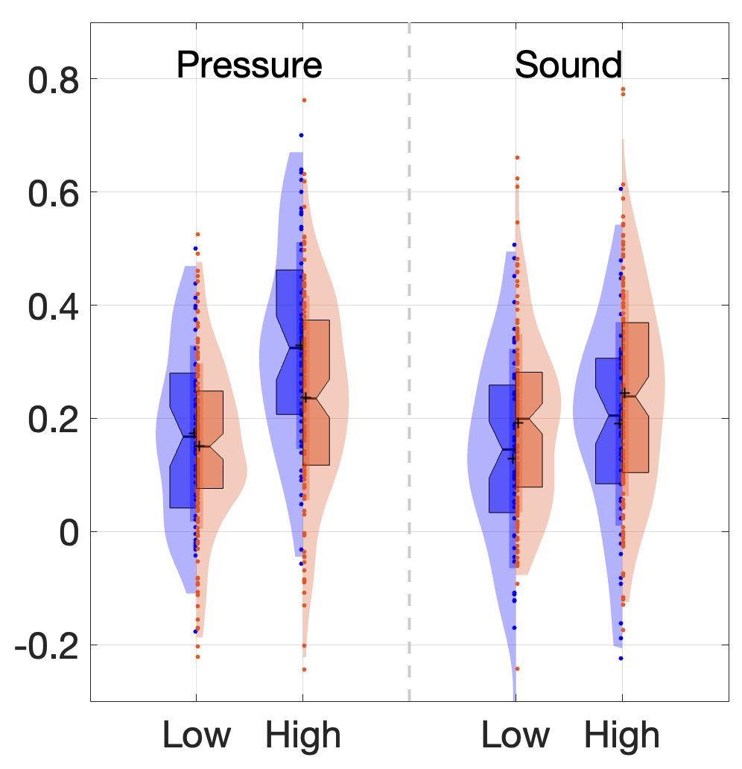
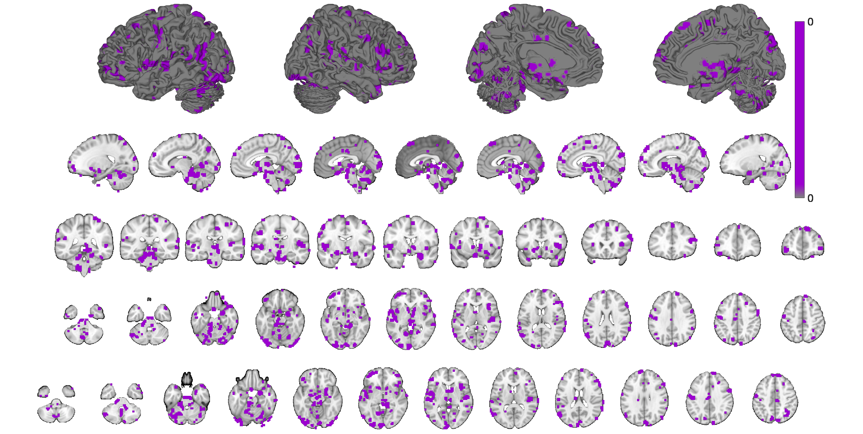
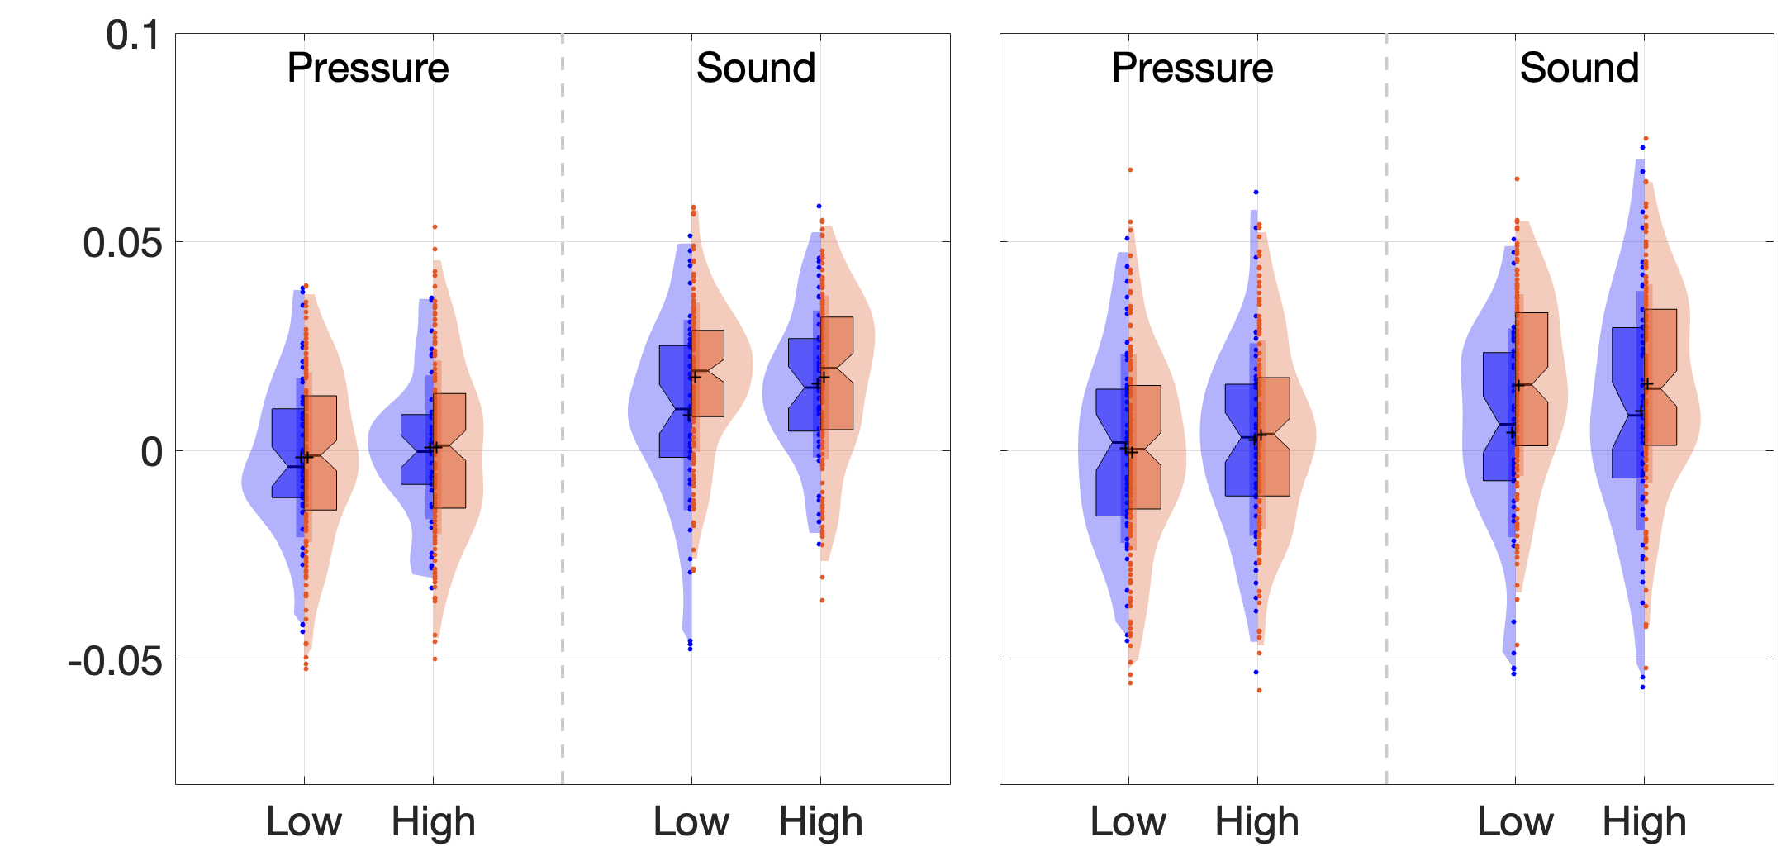
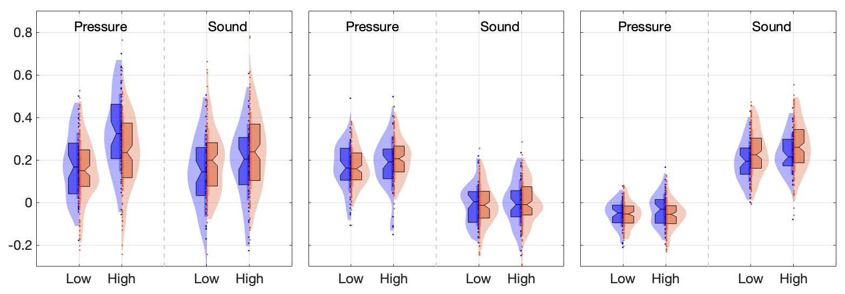
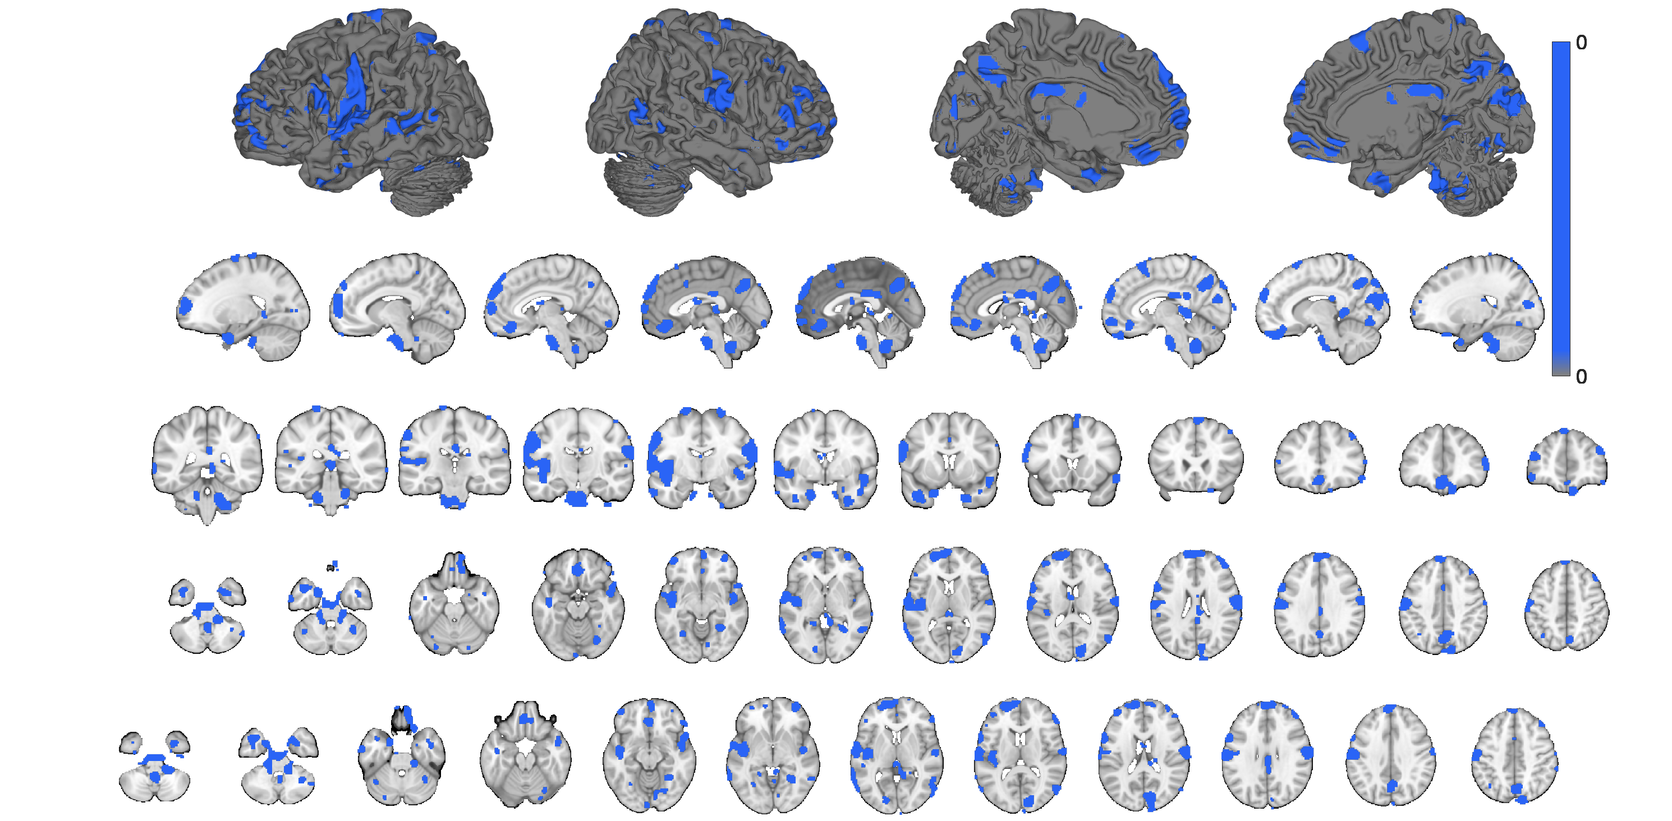
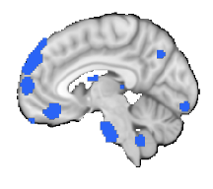
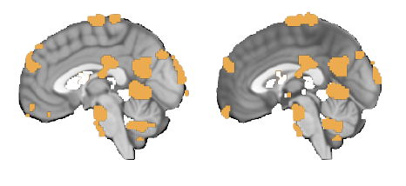
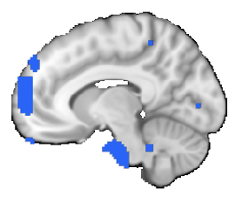
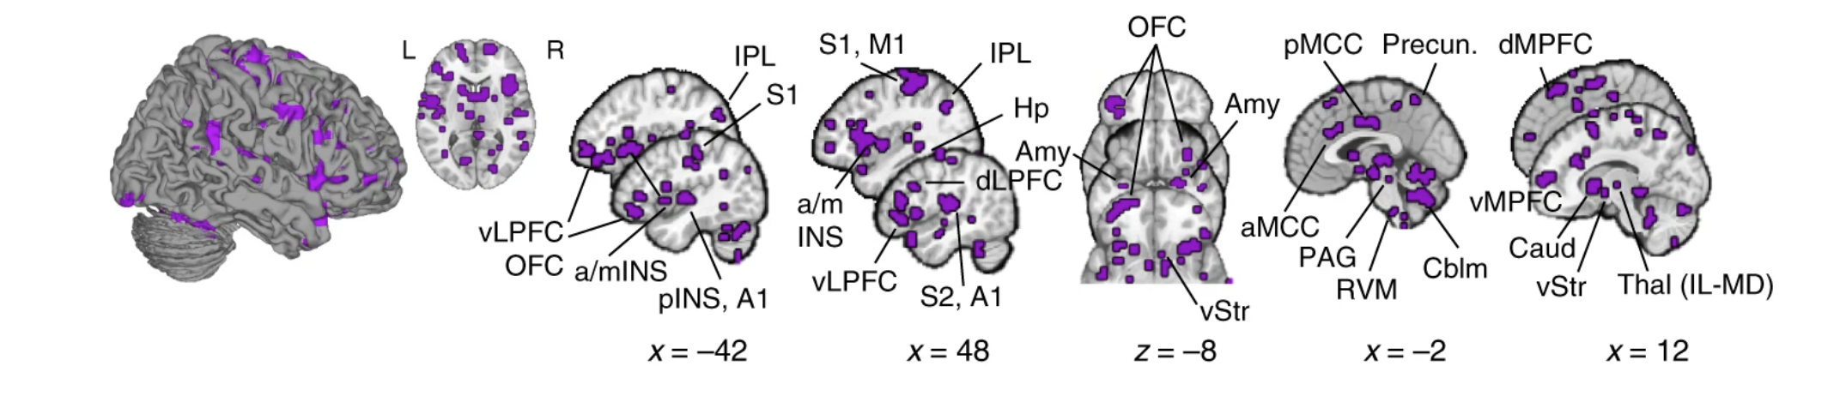
ANNALS OF NEUROLOGY
Negative affect patterns
A
Stimulus-type-specific: Mechanical Pressure
B
Stimulus-type-specific: Aversive Auditory
*
Pattern expression
Pattern expression
S1
A1
C
Multimodal (common) Negative Affect
Amy
Amy
*
*
vStr
Pattern expression
vLPFC
*
OFC
Fibromyalgia patterns
D
Fibromyalgia: Pressure Pain
E
Fibromyalgia: Multisensory Stimulation
Pattern expression
*
Pattern expression
*
Anterior SII
Dorsomedial
PFC
A1
V1
PCC
Controls
Chronic Back Pain
Questions:
• Different y axis values? (for visibility)
• Lables of pattern areas?
Brain slices all the same? x y z? Which labels?
To do: Insert Asterisks

Slide 3

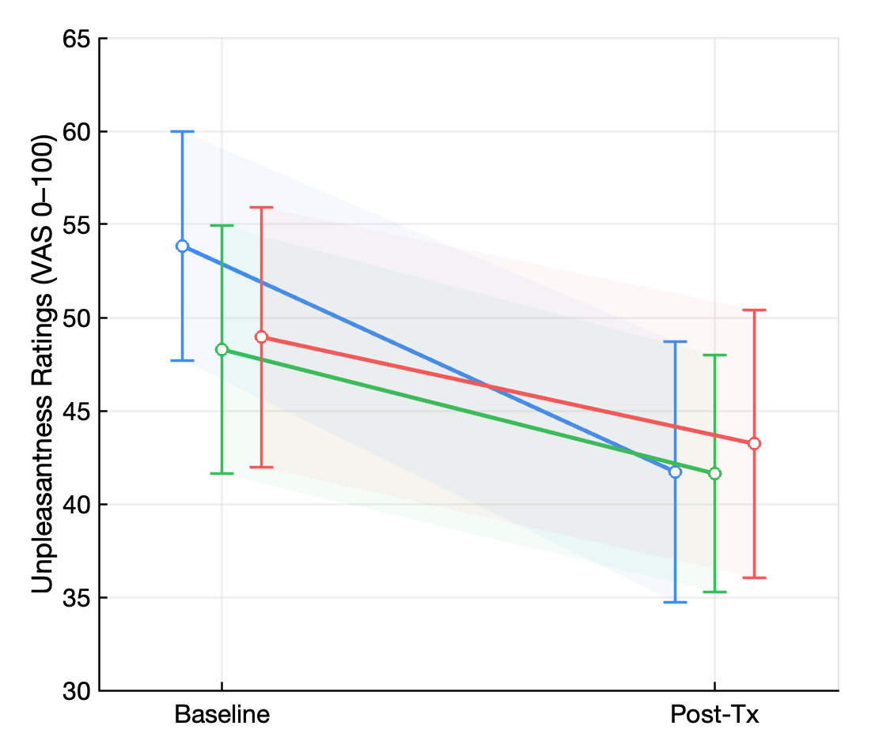
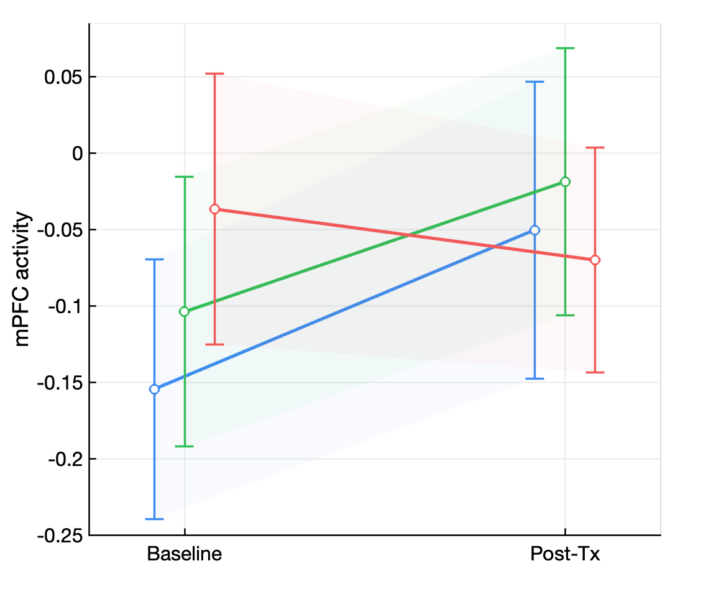
Treatment Effects on Auditory Processing in Chronic Back Pain
A
Auditory Unpleasantness Ratings
B
Medial Prefrontal Cortex Activity
*
*
D
Midline Default-Mode Network Areas
mPFC
PCC
precuneus
PCC
Neural Treatment Changes
D
Medial Prefrontal Cortex
Controls
E
Chronic Back Pain
Precuneus
***
**
***
**
**
Controls
Chronic Back Pain

Slide 4
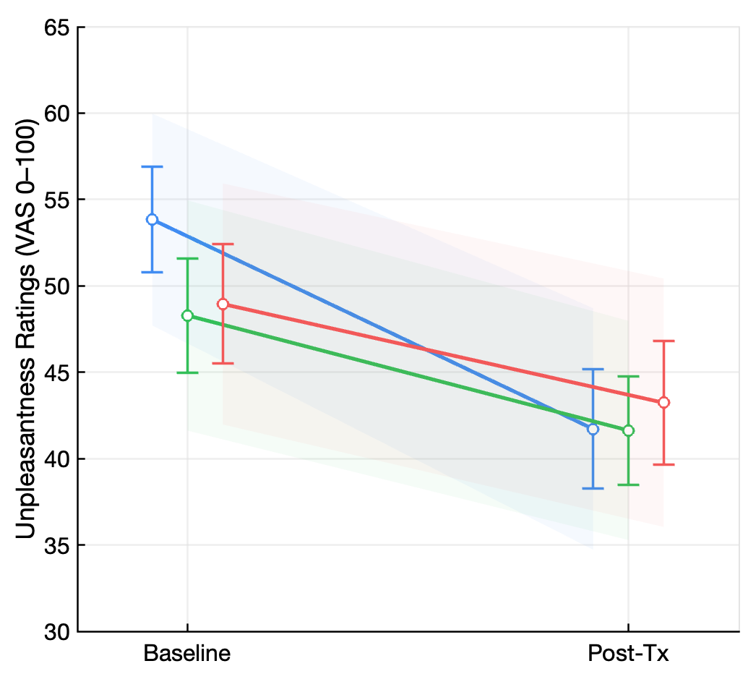
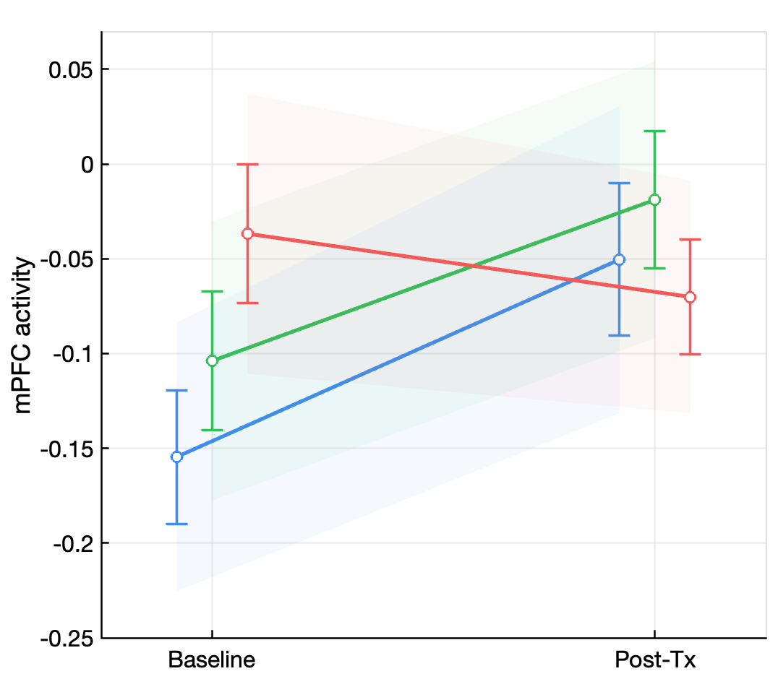
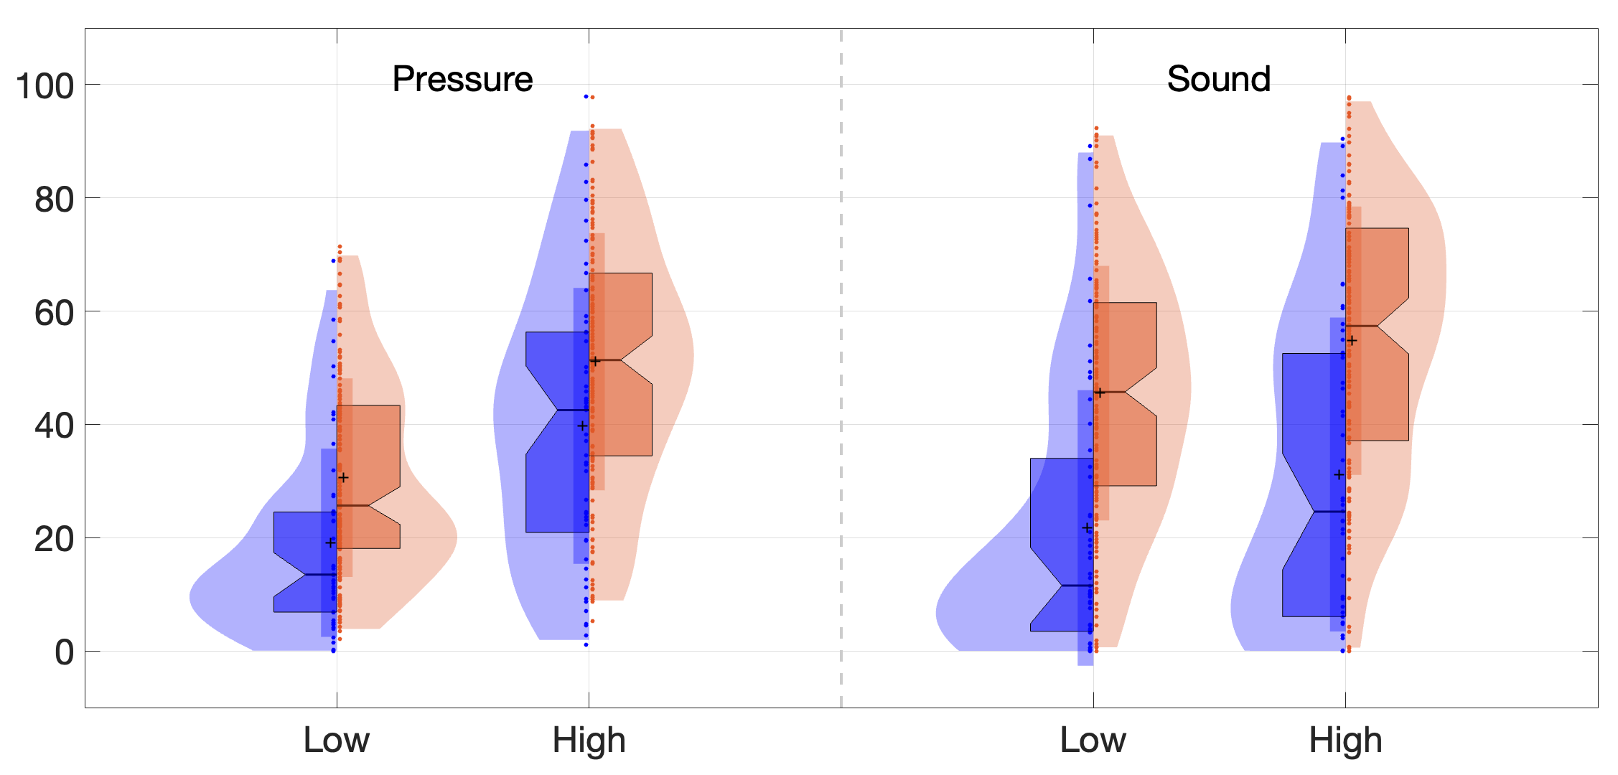
Treatment Effects on Auditory Processing in Chronic Back Pain
A
Auditory Unpleasantness Ratings
B
Medial Prefrontal Cortex Activity
*
*
Unpleasantness Ratings
***
***
Unpleasantness Ratings VAS (0-100)
Controls
Chronic Back Pain

Slide 5
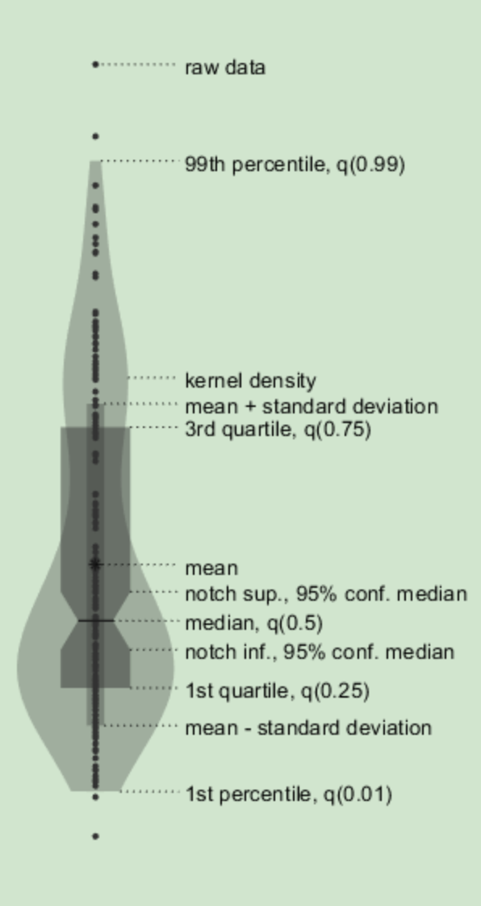
Unpleasantness Ratings
**
***
***
Unpleasantness Ratings VAS (0-100)
***
+
Controls
Chronic Back Pain
2. Group effect df is tied to subjects, not rows
Group is between-subject → denominator df depends on the number of participants and how balanced they are across groups.
If the variance structure differs (e.g., sound ratings have lower within-subject variance than pressure), the Satterthwaite df estimate shifts. That’s why you see ~209 for Sound vs ~245 for Pressure.

Slide 6
ANNALS OF NEUROLOGY
Negative affect patterns
A
Stimulus-type-specific: Mechanical Pressure
B
Stimulus-type-specific: Aversive Auditory
*
Pattern expression
Pattern expression
*
S1
A1
C
Multimodal (common) Negative Affect
Amy
Amy
**
*
vStr
Pattern expression
*
vLPFC
*
OFC
Fibromyalgia patterns
D
Fibromyalgia: Pressure Pain
E
Fibromyalgia: Multisensory Stimulation
Pattern expression
**
Pattern expression
**
Anterior SII
Dorsomedial
PFC
A1
V1
PCC
Controls
Chronic Back Pain
Questions:
• Different y axis values? (for visibility)
• Lables of pattern areas?
Brain slices all the same? x y z? Which labels?
To do: Insert Asterisks

Slide 7
ANNALS OF NEUROLOGY
A
Uni-sensory: Auditory
☐
☐
☐
A1
MGN
IC
**
***
***
***
A1
MGN
IC
***
Modality specific
Intensity encoding
Group differences
B
Uni-sensory: Mechanical
S1 Left
S1 Right
Modality specific
S1 (L)
S1 (R)
Intensity encoding
**
Group differences
C
Sensory-integrative
vIns
dIns
pIns
**
**
**
**
**
**
*
vIns
dIns
pIns
*
*
Modality specific
*
Intensity encoding
Group differences
D
Midline Default-Mode Network Areas
mPFC
precuneus
PCC
***
Questions:
• checkbox?
**
***
mPFC
prec
PCC
**
Modality specific
Intensity encoding
Group differences
Controls
Chronic Back Pain

Slide 8
With mean
Figure 3
Uni-sensory: Auditory
☐
☐
☐
A1
MGN
IC
**
***
***
***
A1
MGN
IC
***
Modality specific
Intensity encoding
Group differences
Uni-sensory: Mechanical
S1 Left
S1 Right
Modality specific
S1 (L)
S1 (R)
Intensity encoding
**
Group differences
Sensory-integrative
vIns
dIns
pIns
**
**
**
**
**
**
*
vIns
dIns
pIns
*
*
Modality specific
*
Intensity encoding
Group differences
Midline Default-Mode Network Areas
mPFC
precuneus
PCC
***
Questions:
• checkbox?
**
***
mPFC
prec
PCC
**
Modality specific
Intensity encoding
Group differences
Controls
Chronic Back Pain

Slide 9
Figure 4
Fibromyalgia patterns
Fibromyalgia: Pressure Pain
Fibromyalgia: Multisensory Stimulation
Pattern expression
**
Pattern expression
**
Anterior SII
Dorsomedial
PFC
A1
V1
PCC
Negative affect patterns
Stimulus-type-specific: Mechanical Pressure
Stimulus-type-specific: Aversive Auditory
*
*
Pattern expression
Pattern expression
*
S1
A1
Multimodal (common) Negative Affect
Amy
Amy
**
*
vStr
Pattern expression
*
vLPFC
OFC
Controls
Chronic Back Pain
Questions:
• Different y axis values? (for visibility)
• Lables of pattern areas?
Brain slices all the same? x y z? Which labels?
To do: Insert Asterisks

Slide 10
Figure 4
Negative affect patterns
Stimulus-type-specific: Mechanical Pressure
Stimulus-type-specific: Aversive Auditory
*
Pattern expression
Pattern expression
*
S1
A1
Multimodal (common) Negative Affect
Amy
Amy
**
*
vStr
Pattern expression
*
vLPFC
*
OFC
Fibromyalgia patterns
Fibromyalgia: Pressure Pain
Fibromyalgia: Multisensory Stimulation
Pattern expression
**
Pattern expression
**
Anterior SII
Dorsomedial
PFC
A1
V1
PCC
Controls
Chronic Back Pain
Questions:
• Different y axis values? (for visibility)
• Lables of pattern areas?
Brain slices all the same? x y z? Which labels?
To do: Insert Asterisks

Slide 11
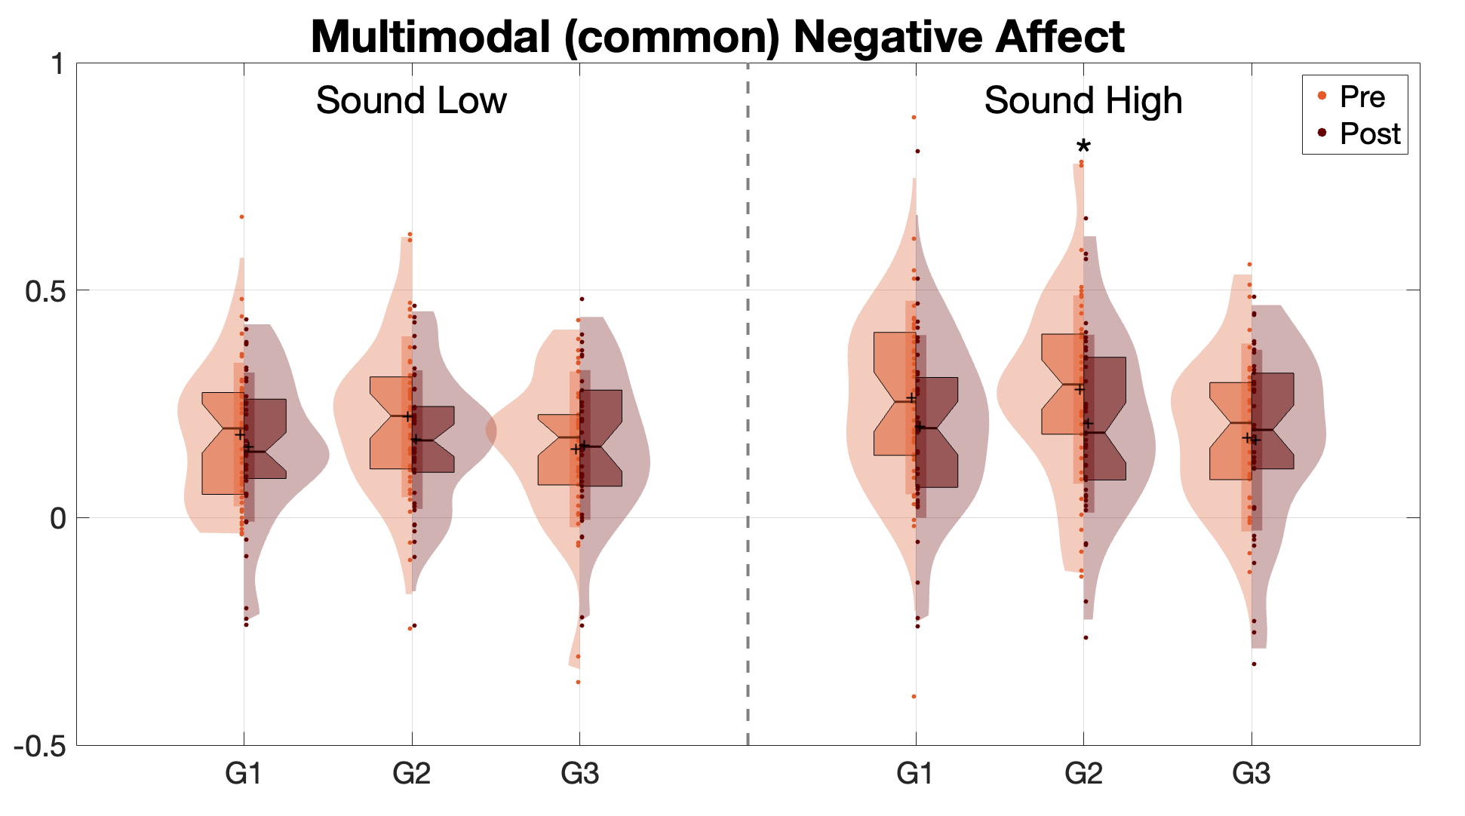
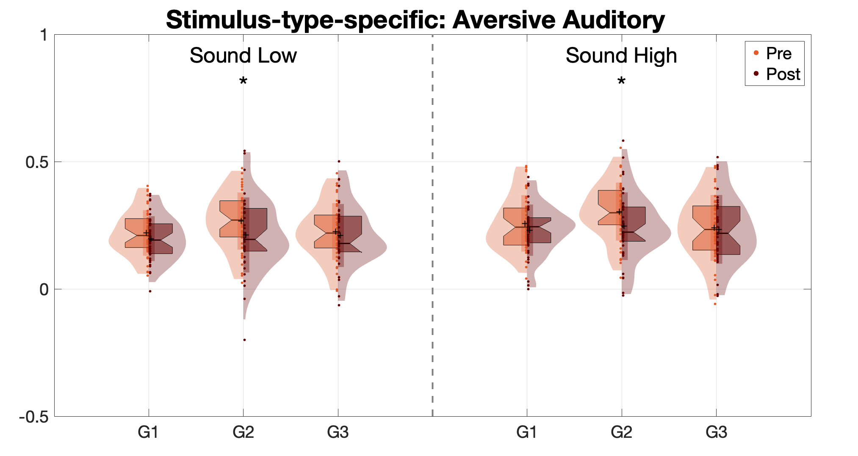
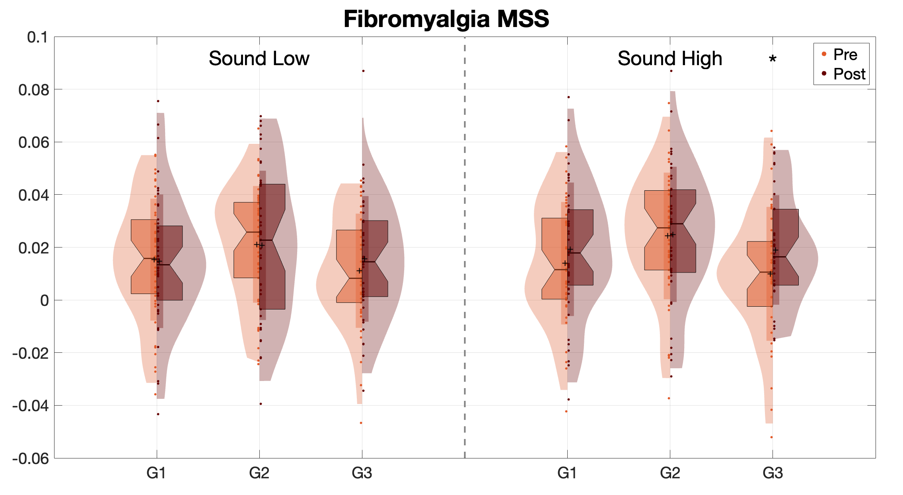
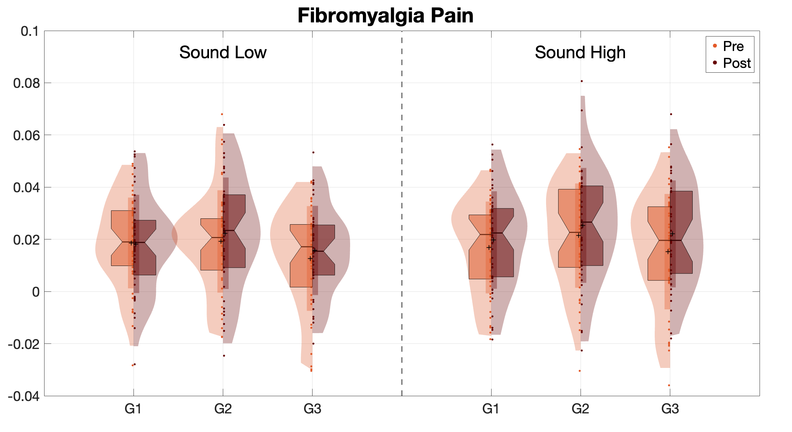
Figure 3
Negative affect patterns
Fibromyalgia patterns

Slide 12
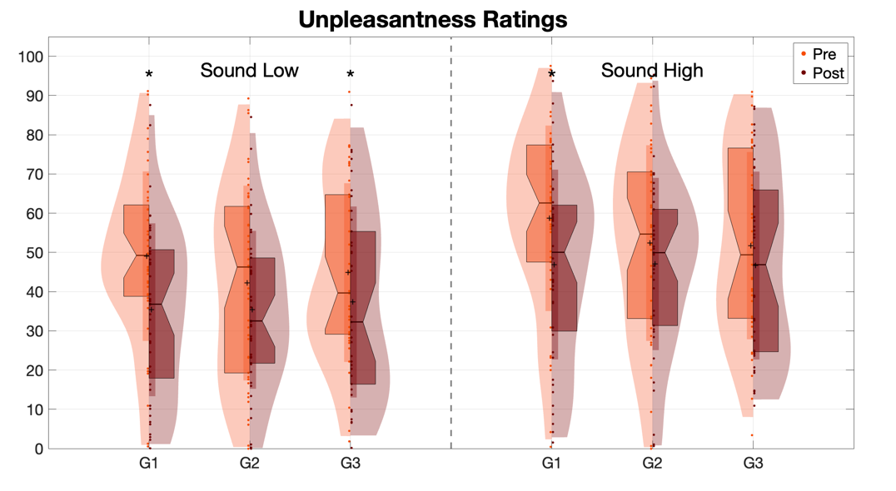
Figure 1
To do:
• Add asterisks

Slide 13
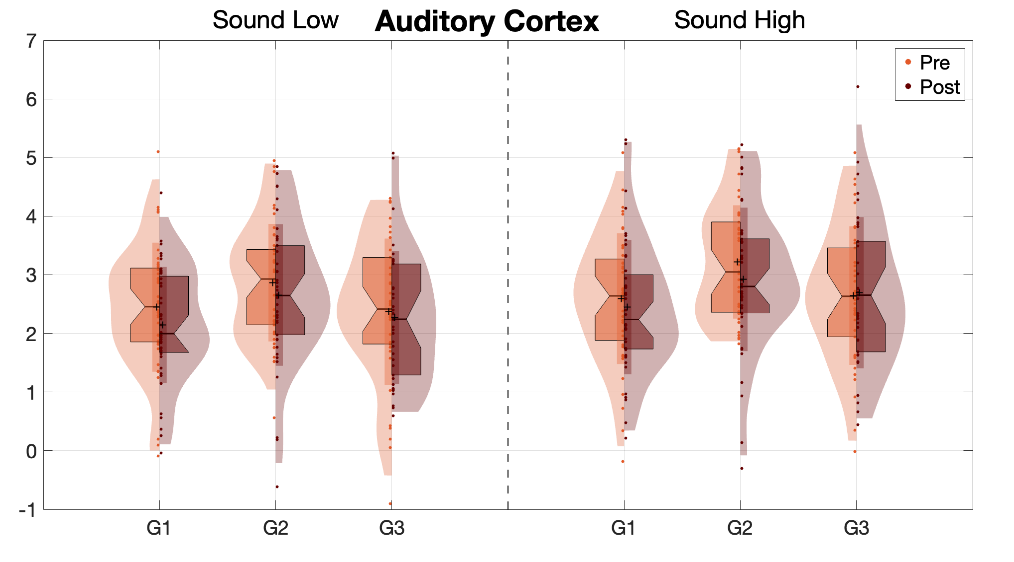
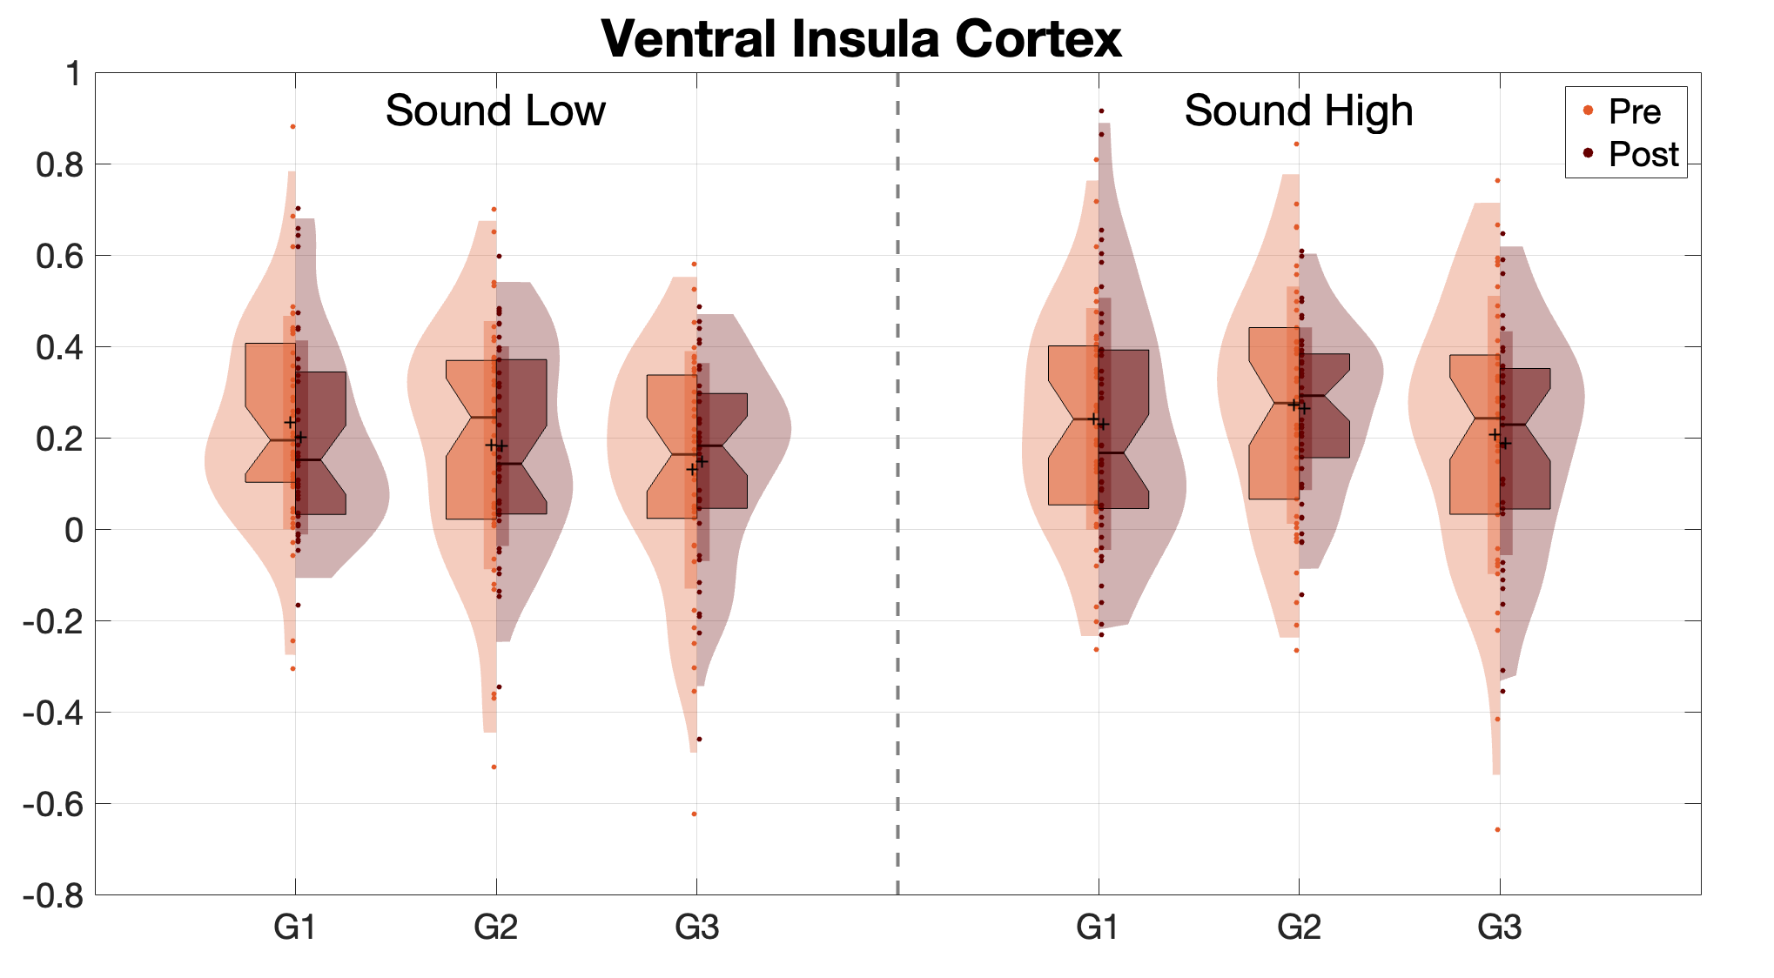


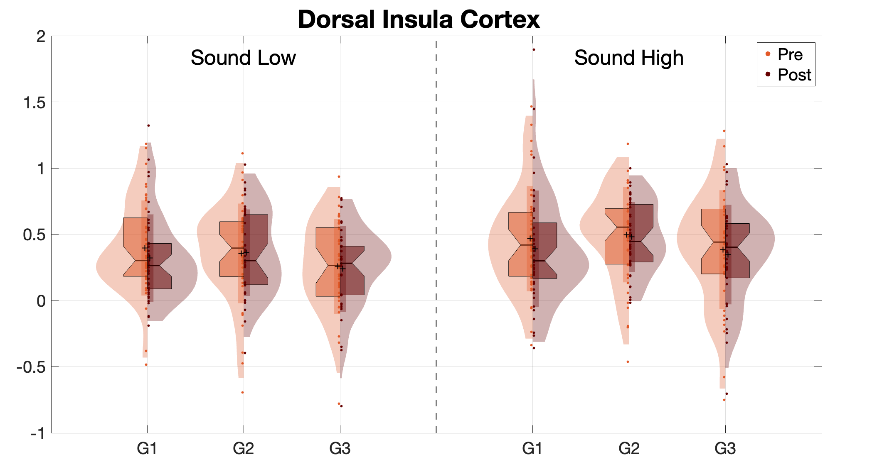
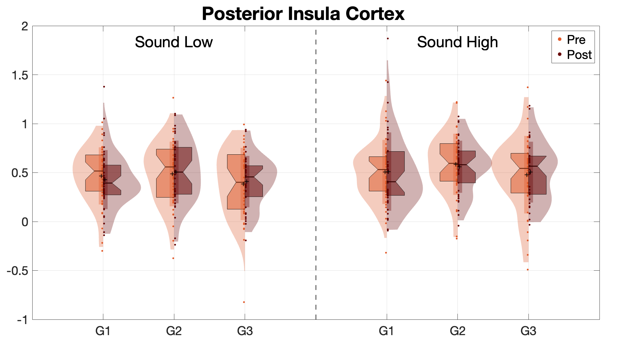

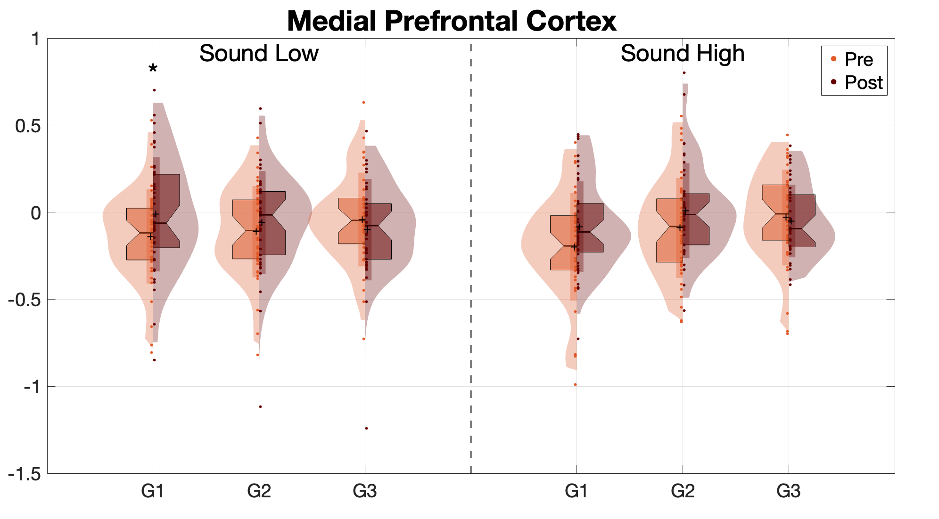
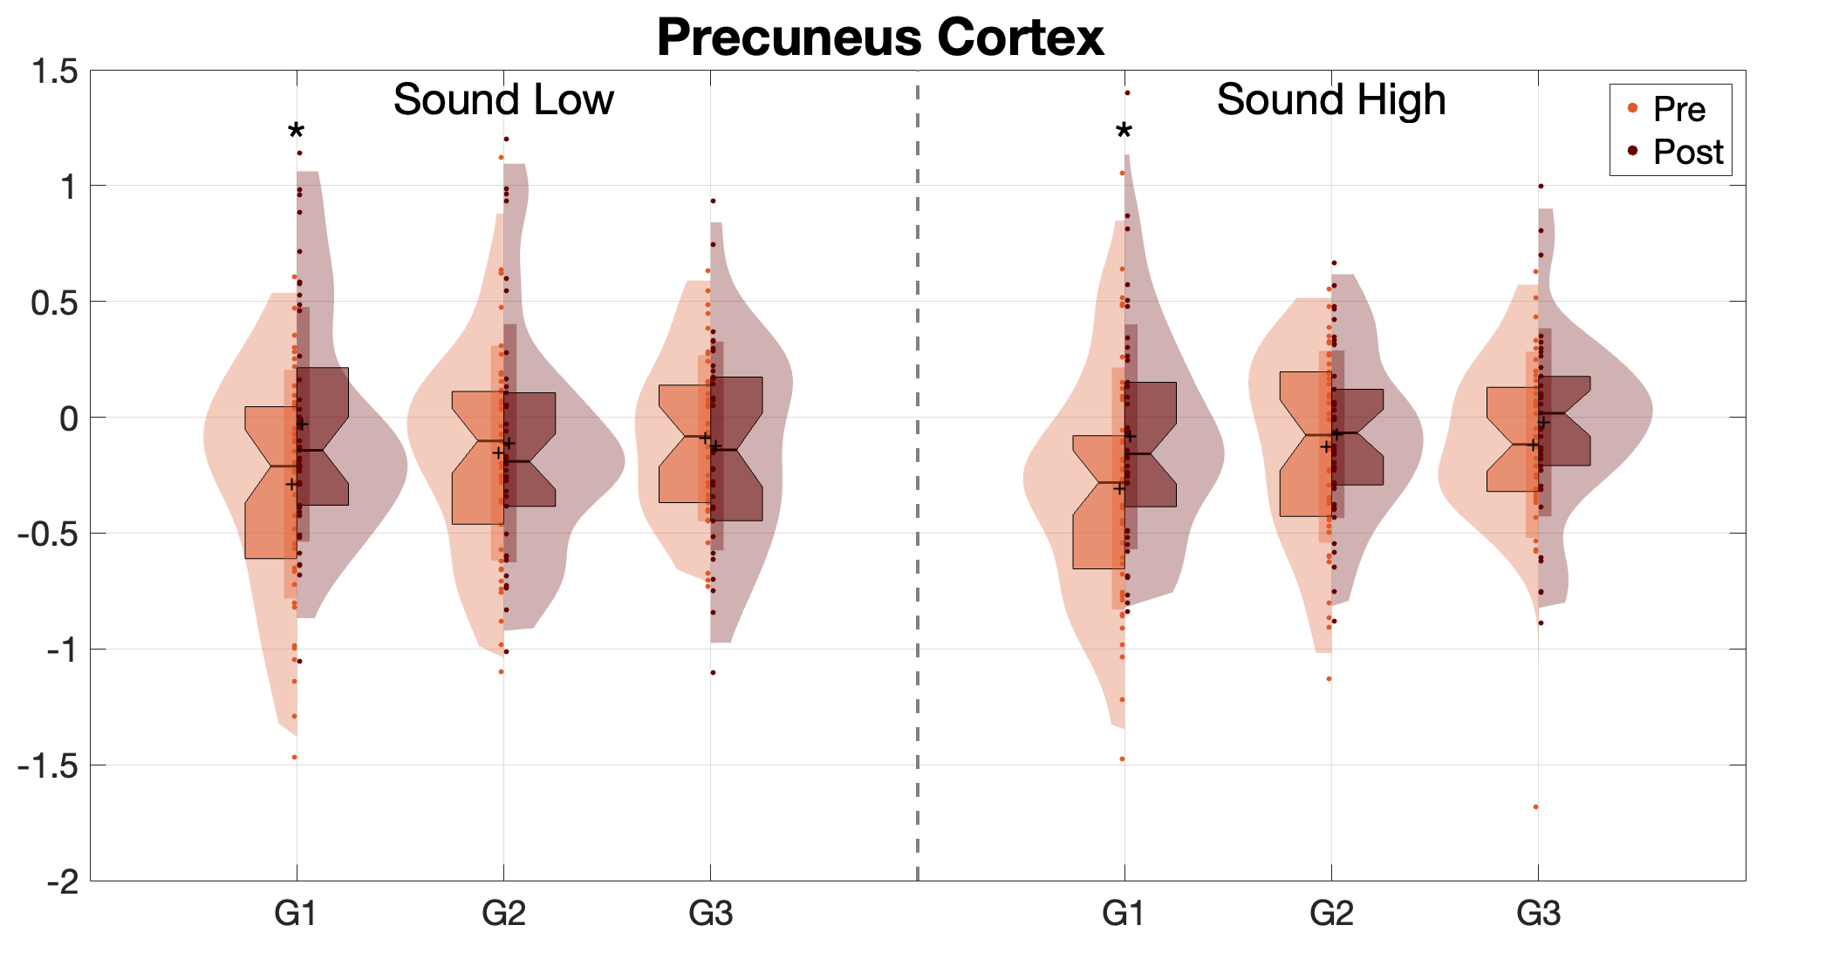
Figure 2
Region of Interest Analysis
**

Slide 14
--- Auditory Cortex (Sound Low) ---
G1: p = 0.0825
G2: p = 0.1973
G3: p = 0.5881
--- Auditory Cortex (Sound High) ---
G1: p = 0.4597
G2: p = 0.0744
G3: p = 0.8084
--- Ventral Insula Cortex (Sound Low) ---
G1: p = 0.4040
G2: p = 0.9669
G3: p = 0.7367
--- Ventral Insula Cortex (Sound High) ---
G1: p = 0.8216
G2: p = 0.8509
G3: p = 0.7370
--- Dorsal Insula Cortex (Sound Low) ---
G1: p = 0.1759
G2: p = 0.9431
G3: p = 0.7892
--- Dorsal Insula Cortex (Sound High) ---
G1: p = 0.3321
G2: p = 0.8057
G3: p = 0.6564
--- Posterior Insula Cortex (Sound Low) ---
G1: p = 0.4644
G2: p = 0.7696
G3: p = 0.6975
--- Posterior Insula Cortex (Sound High) ---
G1: p = 0.9544
G2: p = 0.6736
G3: p = 0.6904
--- Medial Prefrontal Cortex (Sound Low) ---
G1: p = 0.0241 *
G2: p = 0.3100
G3: p = 0.3732
--- Medial Prefrontal Cortex (Sound High) ---
G1: p = 0.0717
G2: p = 0.1025
G3: p = 0.7137
--- Precuneus Cortex (Sound Low) ---
G1: p = 0.0085 **
G2: p = 0.6463
G3: p = 0.7202
--- Precuneus Cortex (Sound High) ---
G1: p = 0.0250 *
G2: p = 0.4627
G3: p = 0.2714
Auditory Cortex Pre vs Post
(Sound Low) ---
G1: p = 0.0825
G2: p = 0.1973
G3: p = 0.5881
--- (Sound High) ---
G1: p = 0.4597
G2: p = 0.0744
G3: p = 0.8084

Slide 15
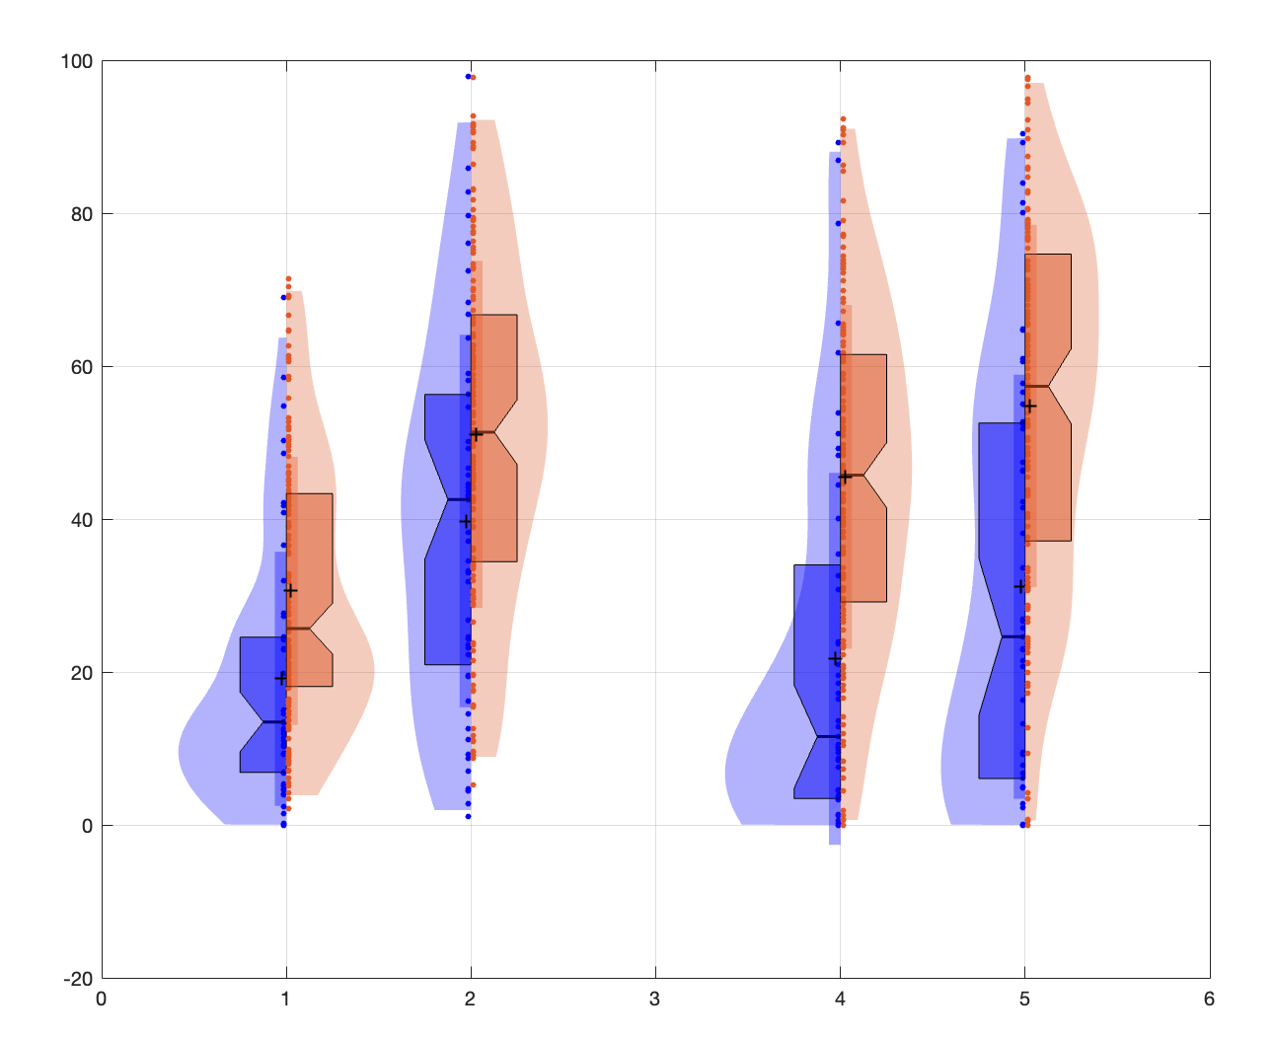
Figure 2
Unpleasantness Ratings
**
***
***
***
+
Controls
Chronic Back Pain

Slide 16

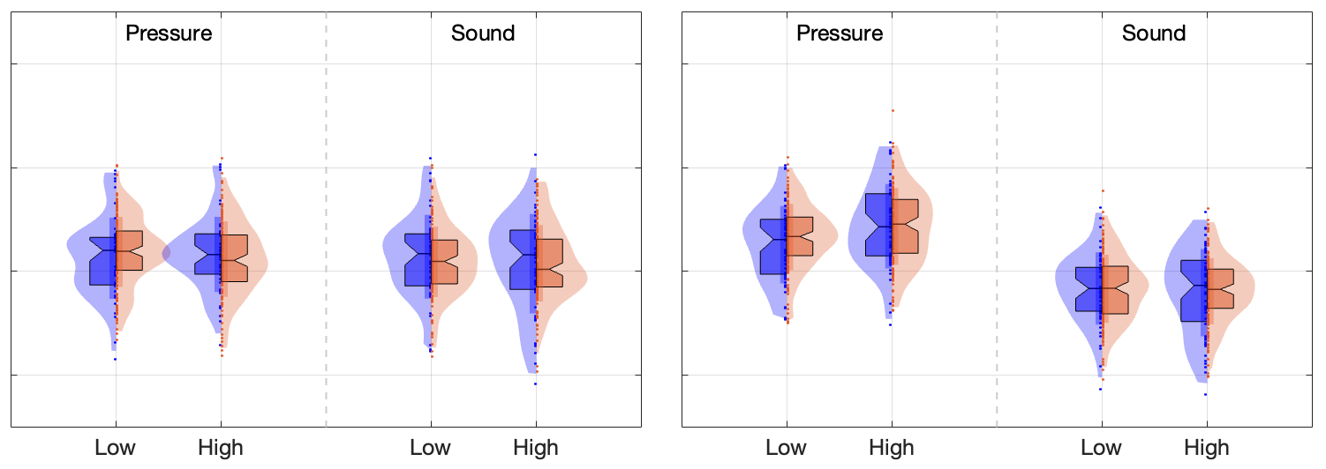
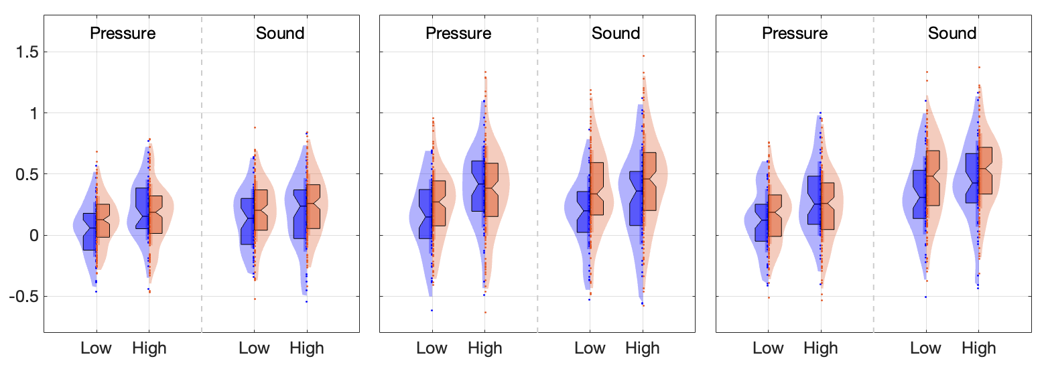
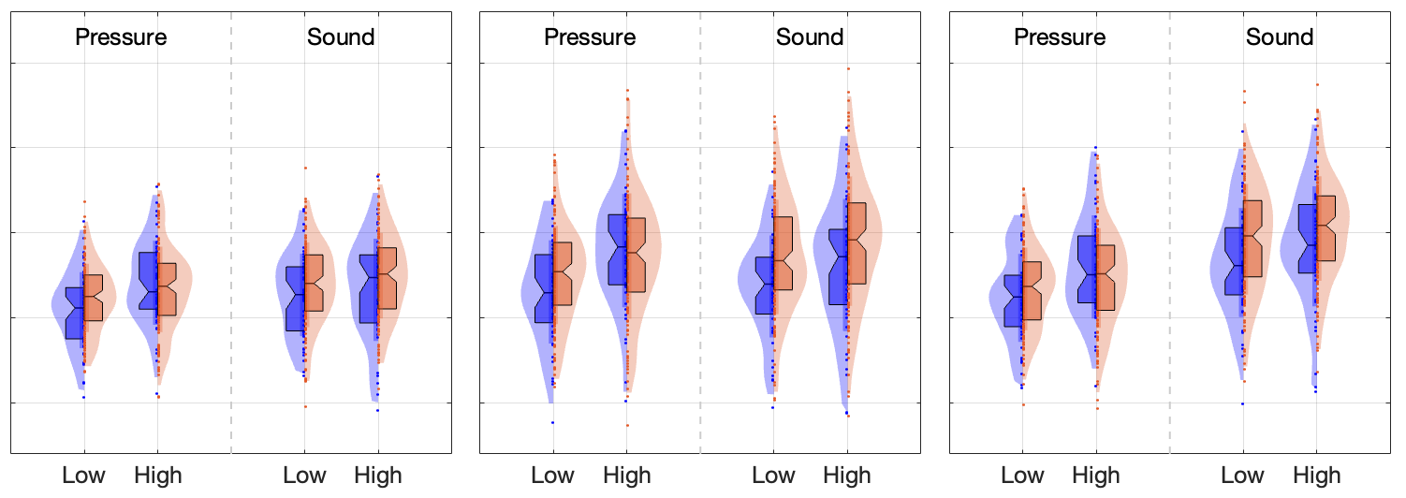
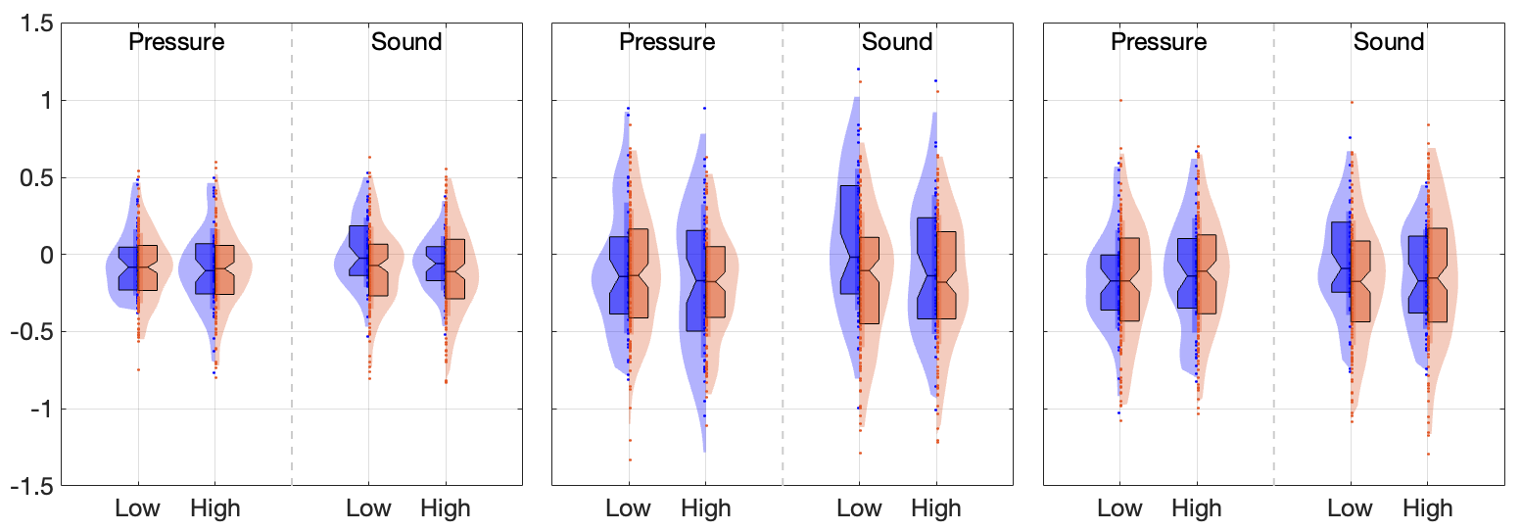
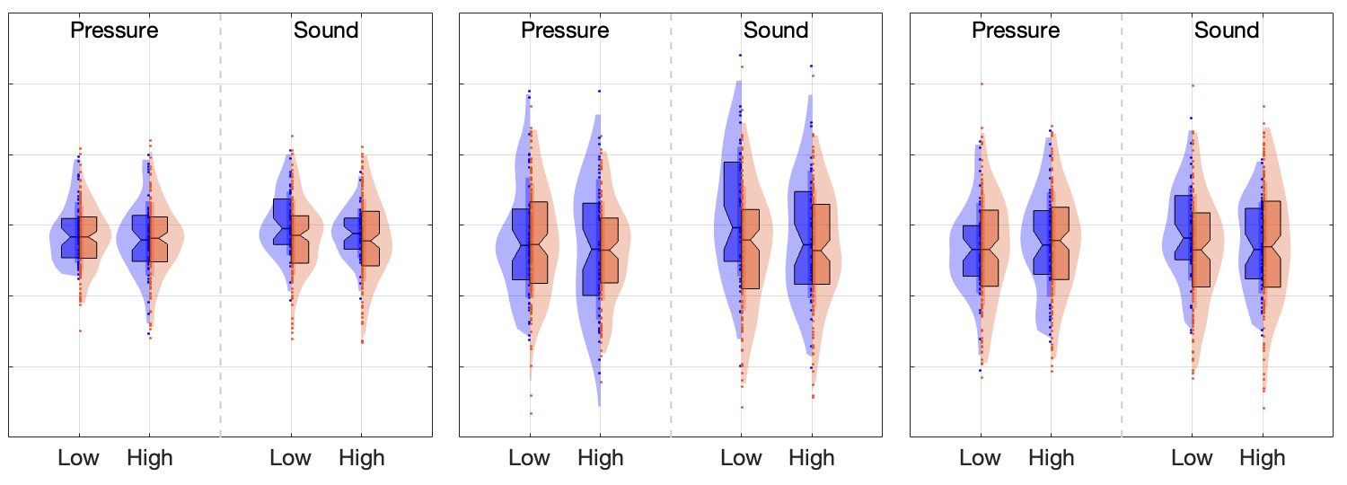
Figure 3
Uni-sensory: Auditory
☐
☐
☐
A1
MGN
IC
**
***
A1
MGN
IC
***
Modality specific
Intensity encoding
Group differences
Uni-sensory: Mechanical
S1 Left
S1 Right
Modality specific
S1 (L)
S1 (R)
Intensity encoding
**
Group differences
Sensory-integrative
vIns
dIns
pIns
**
**
**
vIns
dIns
pIns
*
*
Modality specific
Intensity encoding
Group differences
Midline Default-Mode Network Areas
mPFC
precuneus
PCC
Questions:
• checkbox?
**
***
Modality specific
mPFC
prec
PCC
Intensity encoding
Group differences
Controls
Chronic Back Pain

Slide 17

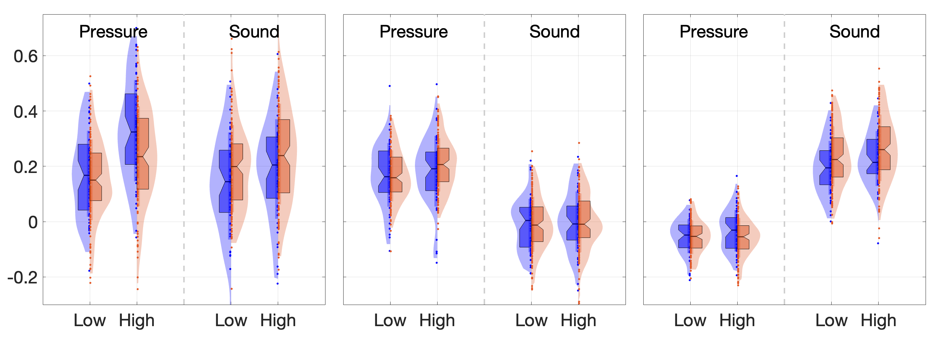
Figure 4
Fibromyalgia patterns
Fibromyalgia: Pressure Pain
Fibromyalgia: Multisensory Stimulation
Pattern expression
**
Pattern expression
**
Anterior SII
Dorsomedial
PFC
A1
V1
PCC
Negative affect patterns
Stimulus-type-specific: Mechanical Pressure
Stimulus-type-specific: Aversive Auditory
*
*
Pattern expression
Pattern expression
*
S1
A1
Multimodal (common) Negative Affect
Amy
Amy
* *
*
vStr
Pattern expression
*
vLPFC
OFC
Controls
Chronic Back Pain
Questions:
• Different y axis values? (for visibility)
• Lables of pattern areas?
Brain slices all the same? x y z? Which labels?
To do: Insert Asterisks

Slide 18
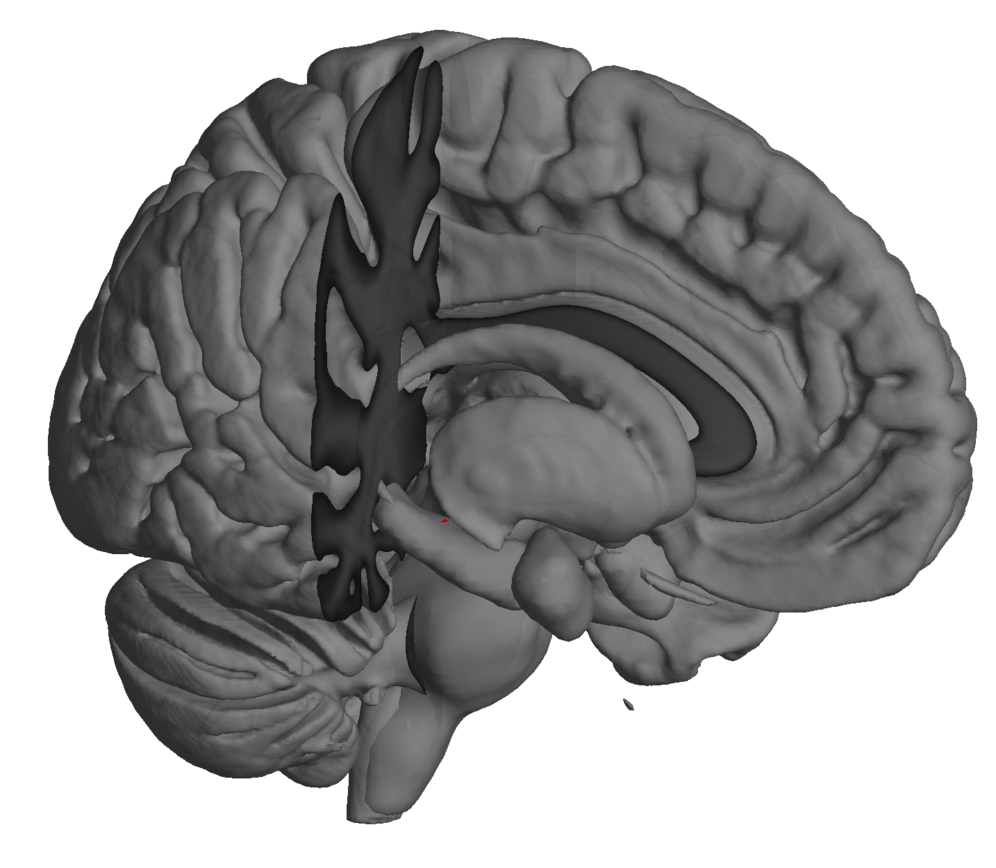
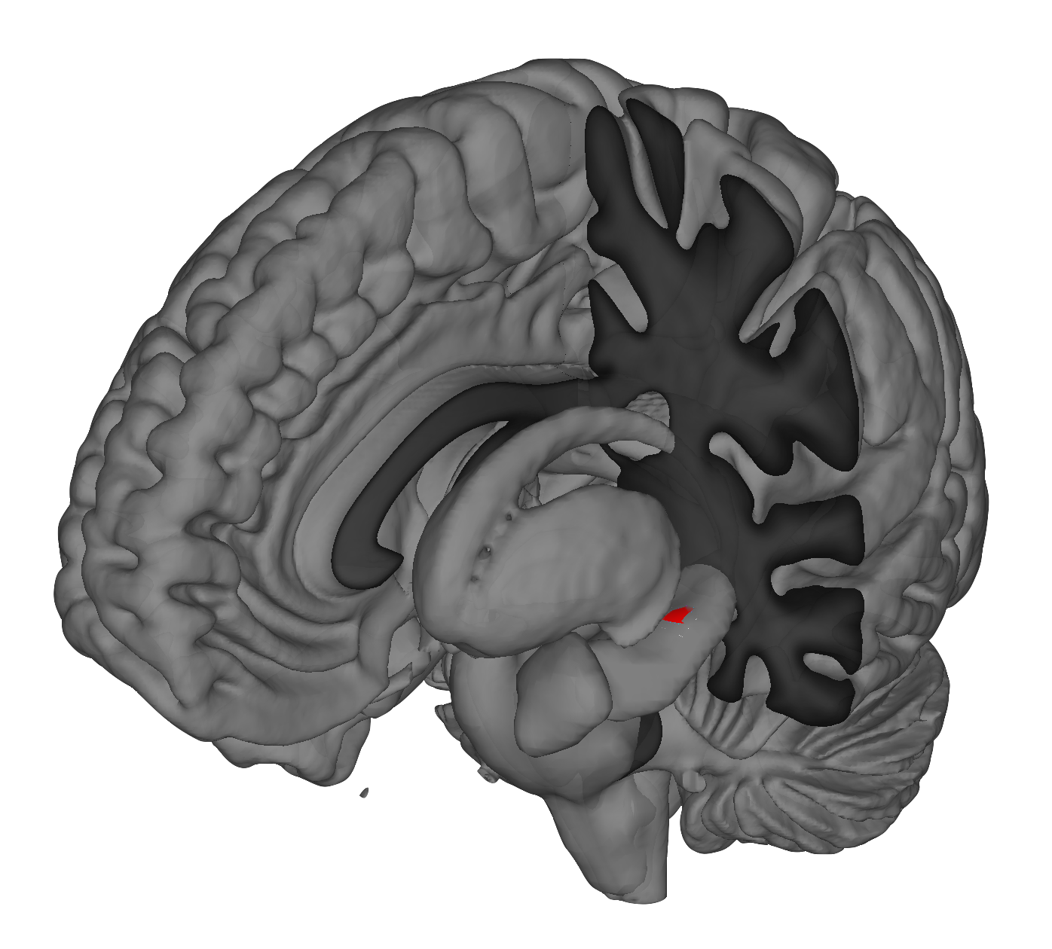





Figure 5
Whole brain voxel-wise analysis: Hippocampal Activity
Activations
Pressure low
Sound low
x = 17, y = -41, z = 8
x = -34, y = -19, z = -10
Deactivations
Pressure high
Sound high
x = 44, y = -22, z = -13
x = -32, y = -41, z = -2

Slide 19
Figure 4
Fibromyalgia patterns
Fibromyalgia: Pressure Pain
Fibromyalgia: Multisensory Stimulation
**
**
**
Negative affect patterns
Multimodal (common) Negative Affect
Stimulus-type-specific: Aversive Auditory
*
*
*
*
*
*
*
*
A1
Stimulus-type-specific: Mechanical Pressure
S1
Controls
Chronic Back Pain
Questions:
• Different y axis values? (for visibility)
• Lables of pattern areas?
Brain slices all the same? x y z? Which labels?
To do: Insert Asterisks

Slide 20


Figure 2
Unpleasantness Ratings
Controls
Chronic Back Pain
Figure 2
Unpleasantness Ratings
**
***
***
***
Controls
Chronic Back Pain

Slide 21
Figure 3
Uni-sensory: Auditory
☐
☐
☐
A1
MGN
IC
**
***
A1
MGN
IC
***
Modality specific
Intensity encoding
Group differences
Uni-sensory: Mechanical
S1 Left
S1 Right
Modality specific
☐
Intensity encoding
☐
**
Group differences
☐
Sensory-integrative
vIns
dIns
pIns
**
**
**
*
*
Modality specific
☐
Intensity encoding
☐
Group differences
☐
Midline Default-Mode Network Areas
mPFC
precuneus
PCC
Questions:
• checkbox?
**
***
Modality specific
☐
Intensity encoding
☐
Group differences
☐
Controls
Chronic Back Pain

Slide 22
Figure 3
Fibromyalgia patterns
Fibromyalgia: Pressure Pain
Fibromyalgia: Multisensory Stimulation
Negative affect patterns
Multimodal (common) negative affect
Stimulus-type-specific: Aversive Auditory
Stimulus-type-specific: Mechanical Pressure
S1
Controls
Chronic Back Pain
Brain slices all the same? x y z? Which labels?
To do: Insert Asterisks

Slide 23



Figure 3
a)
Fibromyalgia patterns
Fibromyalgia: Pressure Pain
Fibromyalgia: Multisensory Stimulation
b)
Negative affect patterns
Multimodal (common) negative affect
Stimulus-type-specific: Aversive Auditory
Stimulus-type-specific: Mechanical Pressure
S1
Controls
Chronic Back Pain
Brain slices all the same? x y z? Which labels?
To do: Insert Asterisks

Slide 24
Figure 3
Fibromyalgia patterns
Fibromyalgia: Pressure Pain
Fibromyalgia: Multisensory Stimulation
Negative affect patterns
Multimodal (common) negative affect
Stimulus-type-specific: Aversive Auditory
Stimulus-type-specific: Mechanical Pressure
S1
Controls
Chronic Back Pain
Brain slices all the same? x y z? Which labels?
To do: Insert Asterisks

Slide 25
Figure 3
Fibromyalgia patterns
Fibromyalgia: Pressure Pain
Fibromyalgia: Multisensory Stimulation
Negative affect patterns
Multimodal (common) negative affect
Stimulus-type-specific: Aversive Auditory
Stimulus-type-specific: Mechanical Pressure
S1
Controls
Chronic Back Pain
Brain slices all the same? x y z? Which labels?
To do: Insert Asterisks

Slide 26
Figure 3
Fibromyalgia patterns
Fibromyalgia: Pressure Pain
Fibromyalgia: Multisensory Stimulation
Controls
Chronic Back Pain
Negative affect patterns
Multimodal (common) negative affect
Stimulus-type-specific: Aversive Auditory
Stimulus-type-specific: Mechanical Pressure
Controls
Chronic Back Pain
S1
Controls
Chronic Back Pain
Brain slices all the same? x y z? Which labels?
To do: Insert Asterisks

Slide 27
Figure 3
Fibromyalgia patterns
Fibromyalgia: Pressure Pain
Fibromyalgia: Multisensory Stimulation
Negative affect patterns
Multimodal (common) Negative Affect
Stimulus-type-specific: Aversive Auditory
Stimulus-type-specific: Mechanical Pressure
S1
Controls
Chronic Back Pain
Brain slices all the same? x y z? Which labels?
To do: Insert Asterisks

Slide 28
Figure 3
Uni-sensory Auditory
Negative affect patterns
Multimodal (common) Negative Affect
Stimulus-type-specific: Aversive Auditory
Stimulus-type-specific: Mechanical Pressure
S1
Controls
Chronic Back Pain

Slide 29





Midline Default-Mode Network

Slide 30
Figure 3
Uni-sensory: Auditory
Negative affect patterns
Multimodal (common) Negative Affect
Stimulus-type-specific: Aversive Auditory
Stimulus-type-specific: Mechanical Pressure
S1
Controls
Chronic Back Pain

Slide 31
Figure 3
Uni-sensory: Auditory
Modality specific
☐
Intensity encoding
☐
Group differences
☐
Uni-sensory: Mechanical
Modality specific
☐
Intensity encoding
☐
Group differences
☐
Sensory-integrative
Modality specific
☐
Intensity encoding
☐
Group differences
☐
Self-referential Areas
Modality specific
☐
Intensity encoding
☐
Group differences
☐

Slide 32
Figure 3
Uni-sensory: Auditory
Modality specific
☐
Intensity encoding
☐
Group differences
☐
***
Uni-sensory: Mechanical
Modality specific
☐
Intensity encoding
☐
Group differences
☐
Sensory-integrative
Modality specific
☐
Intensity encoding
☐
Group differences
☐
Self-referential Areas
Modality specific
☐
Intensity encoding
☐
Group differences
☐

Slide 35




Slide 36

Aversive Audio
General Common Aversive
Mechanical
FM PAIN
FM MSS

